Slide 1

Monday, the tenth of October
Classwork p. 45

Slide 2
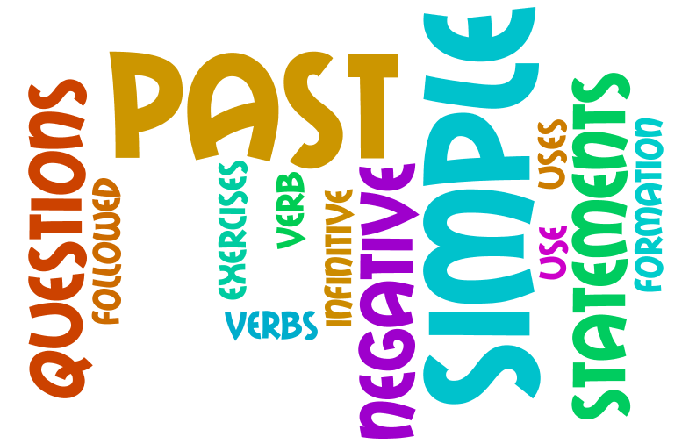
Past Simple

Slide 3

Remember!
Простий минулий час
(Past Simple Tense)
позначає дію, яка відбулася в минулому.

Slide 4
Всі дієслова поділяютьсяся на правильні і неправильні
правильні
like – liked
watch – watched
play – played
count – counted
неправильні
sleep – slept
swim – swam
go – went
have – had

Slide 5

Remember!
Слова-спутники
минулого простого часу:
yesterday - вчора
the day before yesterday - позавчора
last month – в минулому місяці
last year – в минулому році
last week – минулої неділі
a year ago – рік назад
a week ago – тиждень тому
in 2009 – в 2009 році

Slide 6
Remember!
Щоб запитати в минулому простому часі,
або заперечити на допомогу приходить
допоміжне дієслово
did

Slide 7
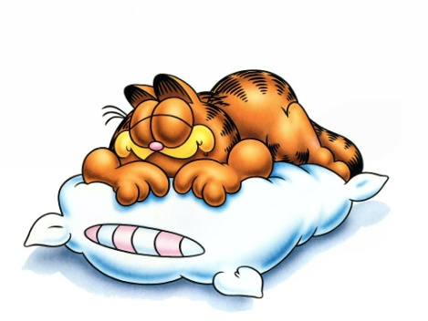
I
watched TV
yesterday.
Did
you
watch TV
yesterday
?
did not
watch TV
I
yesterday.

Slide 8
Present Perfect

Slide 9
Present Perfect
He,she,it +has
+V3 (V+ed)
I,we,you,they +have
*** V3 – Past participle

Slide 10
Signal words
Already
yet
ever
never
just
before

Slide 11
The PRESENT PERFECT tense is used:

Slide 12
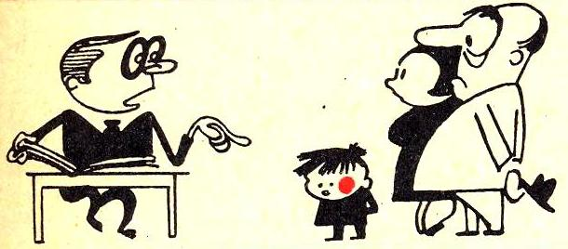
1) to express a present
RESULT of the past actions :
“He hasn’t done his homework”.

Slide 13
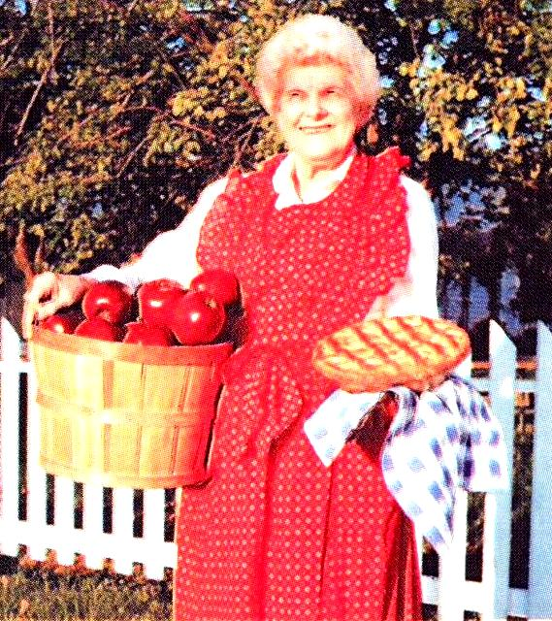
RESULT
She has picked a lot of apples.

Slide 14
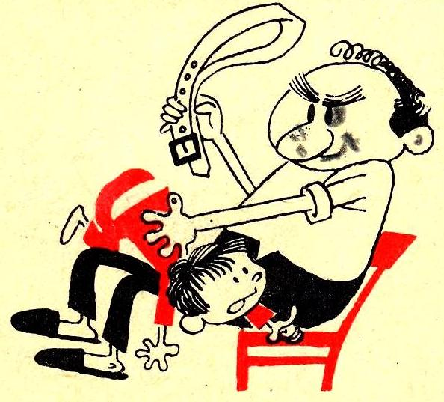
2) to express life experience (ever, never):
“Have you ever been a child?”

Slide 15
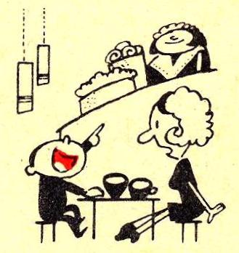
3) to express a PAST action, period of time isn’t finished (already, just, yet, this year):
“You have already had six cakes!”.

Slide 16
4) to present new information:
“Wow! I’ve got a 5!”

Slide 17
new information
“The police have arrested two men”

Slide 18
5). “It is the (first) time smth. has happened”
“It is the (first) time
I have won a lotery!”

Slide 19
7). With state verbs instead of Continuous: be, dislike, enjoy, feel, hate, hear, know, like, prefer, remember, see, smell, taste, etc.
«I have always liked this film».

Slide 20
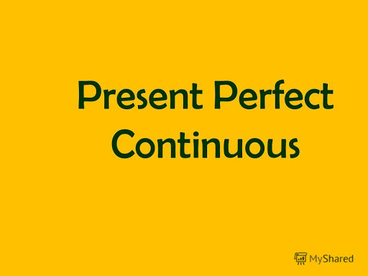

Slide 21
Formula Present Perfect Continuous Tense
have
has
+ been + Ving

Slide 22
For – протягом
Since – з, від, з того часу як
All day (all my life,... ) – весь день ( все життя, ... )
Recently - нещодавно
Lately – останнім часом
For a long time - довго

Slide 23
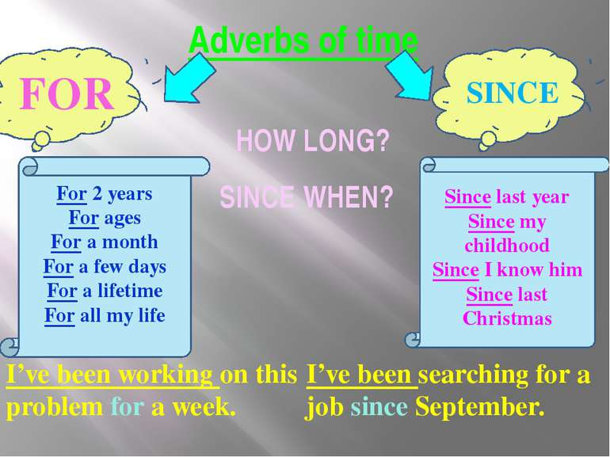

Slide 24
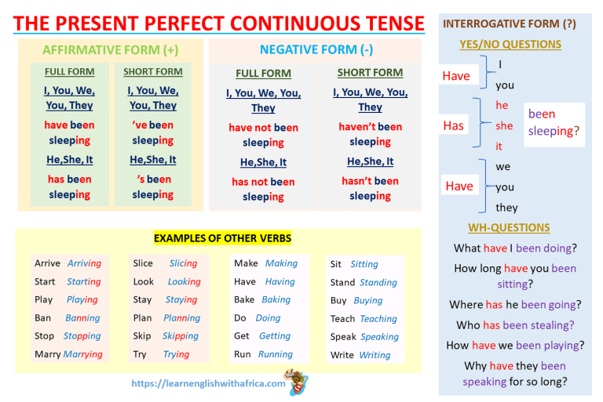

Slide 25
We use Present Perfect Progressive for:
A repeated action or situation which started in the past and continues up to the present
Tom has been repairing his car all day
An action which was happening over a period of time in the past and may have finished? But its results are obvious in the present
He is very tired. He’s been studying all night

Slide 26
Present Perfect Progressive vs
Present Perfect Simple
Present Perfect Progressive | Present Perfect Simple
Акцент на тривалості дії | Акцент на завершеності дії, та її результаті в теперішньому
I’ve been reading the book that you recommended. It’s amazing! (Я читаю книгу, ще не закінчила) How long? I’ve been reading since morning He has been driving for 5 hours They have been playing for 20 min | I’ve read the book that you recommended ( Книга прочитана) How many? I’ve read 200 pages He has driven 500 km They have scored 2 goals

Slide 27
Present Perfect Progressive | Present Perfect Simple
Focus on the activity | Focus on the result
She has been doing her homework so she is tired Why is the kitchen in such a mess? I’ve been making cookies. | She has done all her homework so she can relax this evening I’ve made cookies

Slide 28
Є дієслова які не вживаються в часах групи Continuous( Progressive)
Stative verbs
Це дієслова стану:
be, dislike, enjoy, feel, hate, hear, know, like, prefer, remember, see, smell, taste, believe, etc
I’ve known John for two years.
I’ve believed in God all my life.

Slide 29
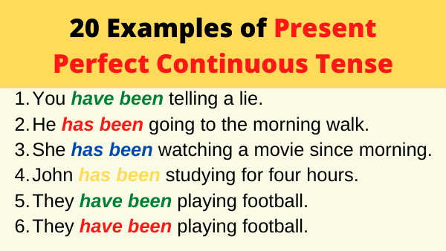

Slide 30
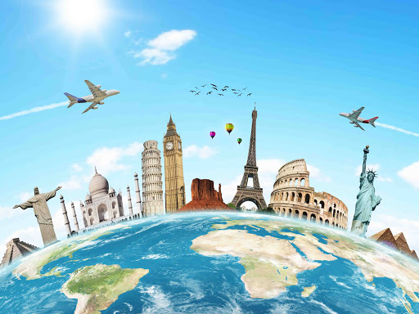
Past Simple
vs
Present Perfect
vs
Present Perfect Continuous

Slide 31
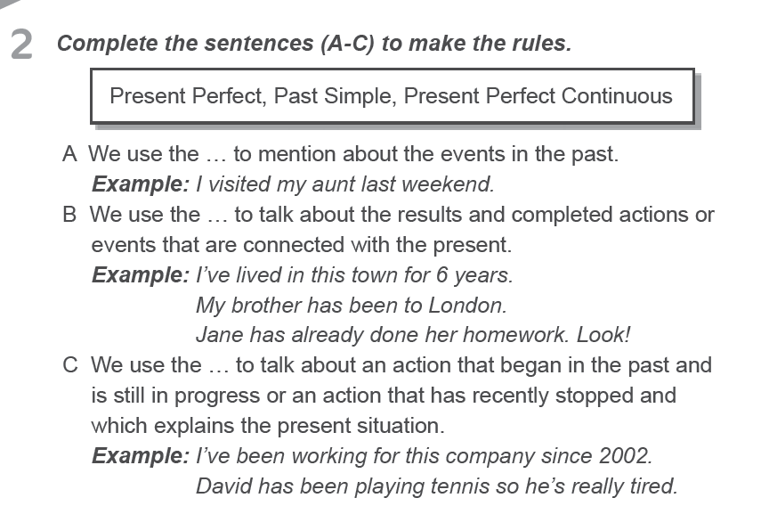
p. 46

Slide 32
3 Read and make up sentences saying how long the people have been doing different things.
Example: Paula started laughing ten minutes ago and she is still laughing. (She/ laugh)
She has been laughing for ten minutes.
p. 46-47

Slide 33
1. The Carltons bought their car two years ago and they still have it. (They / drive)

Slide 34
1. The Carltons bought their car two years ago and they still have it. (They / drive)
They have been driving for two years.

Slide 35
2. Kitty’s brother jumped in the pool at 12. It’s now 1 p.m. and he’s still in the pool. (He / swim)

Slide 36
2. Kitty’s brother jumped in the pool at 12. It’s now 1 p.m. and he’s still in the pool. (He / swim)
He has been swimming for an hour

Slide 37
3. Sheila came to work at 9. It’s now 5 p.m. and she’s still at work.(She / work)

Slide 38
3. Sheila came to work at 9. It’s now 5 p.m. and she’s still at work. (She / work)
She has been working for eight hours

Slide 39
4. We got our mixer in 2001. We still use it.(We / use)

Slide 40
4. We got our mixer in 2001. We still use it.(We / use)
We have been using it for 21 years.

Slide 41
5. Ben started telling jokes at 6 in the afternoon. It’s now 8 and he hasn’t stopped.(He / tell )

Slide 42
5. Ben started telling jokes at 6 in the afternoon. It’s now 8 and he hasn’t stopped.(He / tell )
He has been telling jokes for 2 hour.

Slide 43
6. Mark and Will started playing a computer game at 4 p.m. It’s now 6 and they are still playing. (They / play)

Slide 44
6. Mark and Will started playing a computer game at 4 p.m. It’s now 6 and they are still playing. (They / play)
They have been playing a computer game for 2 hours.

Slide 45
7. I started drawing a picture in the morning and I am still doing it now, at 7 p.m. (I / draw )
I have been drawing a picture all day.

Slide 46
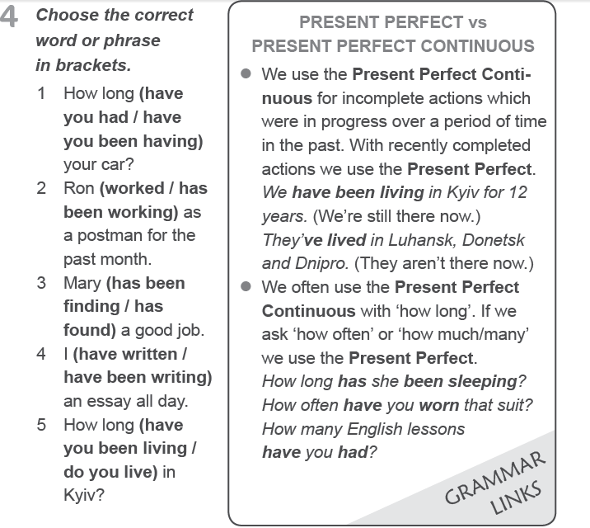
p. 47

Slide 47
p. 47

Slide 48
p. 47

Slide 49
p. 47

Slide 50
p. 47

Slide 51
p. 47

Slide 52
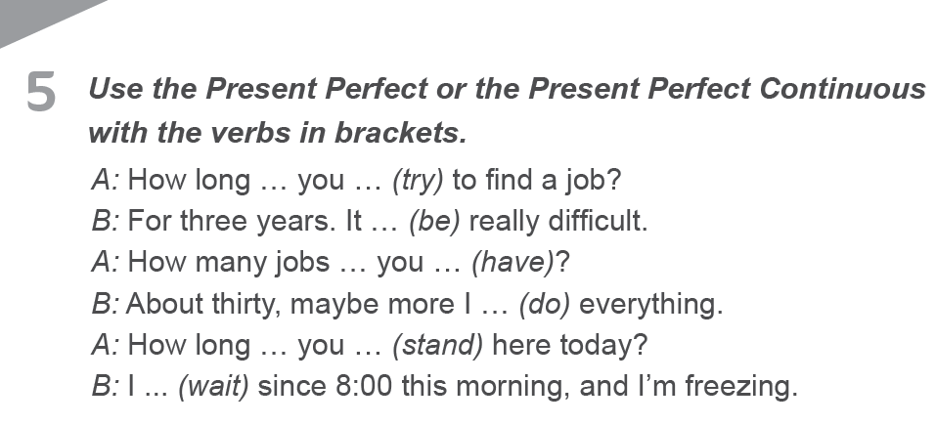
p. 48

Slide 53
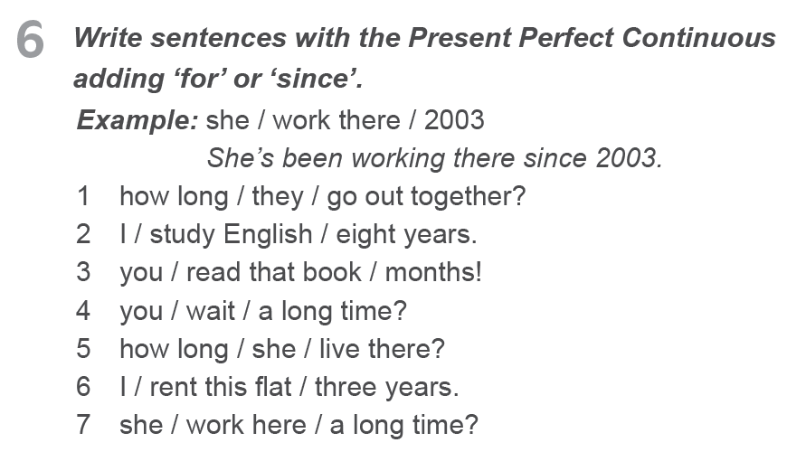
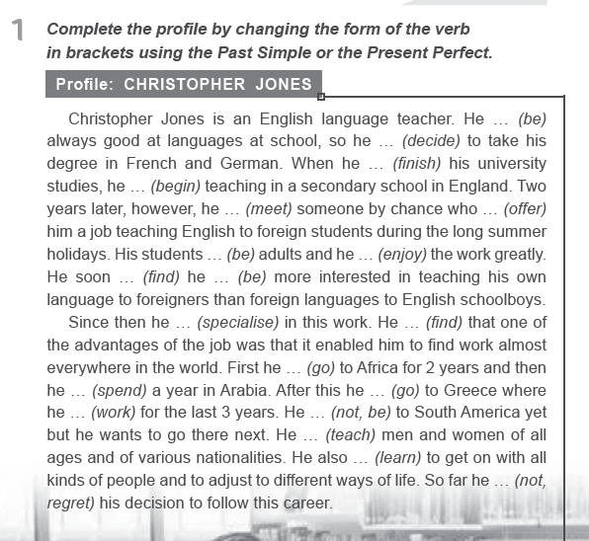
https://vseosvita.ua/test/start/kgu055
Homework p. 45-48

