Slide 1
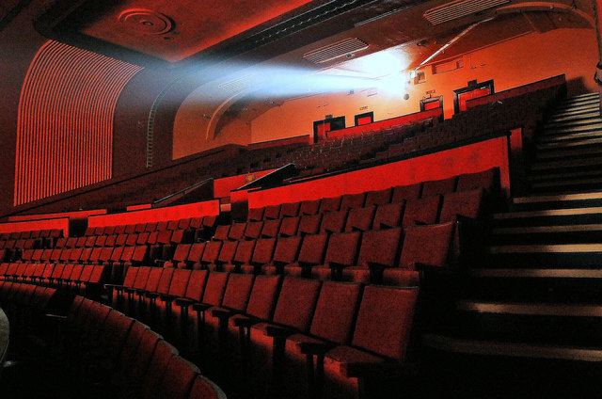
Cinema of the United Kingdom

Slide 2
The United Kingdom has had a brilliant film industry for more than 100 years. There were several periods which stayed in history like the "golden age" of British cinema. Many British actors are successful worldwide: Audrey Hepburn, Maggie Smith, Sean Connery, Gary Oldman, Emma Thompson, Hugh Grant and Kate Winslet. Some of the films with the largest ever box office returns have been made in the United Kingdom, including Harry Potter and James Bond.
Some people and film critics still argue about British cinema and its connection to Hollywood because it deals with the American industry. A lot of British-born directors, including Alfred Hitchcock, Christopher Nolan and Ridley Scott, and performers, such as Charlie Chaplin, have achieved success through their work in the United States. https://www.youtube.com/watch?v=p_xEBVyVWzc

Slide 3
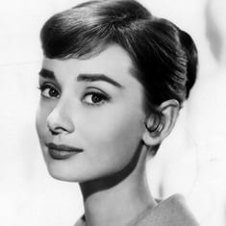
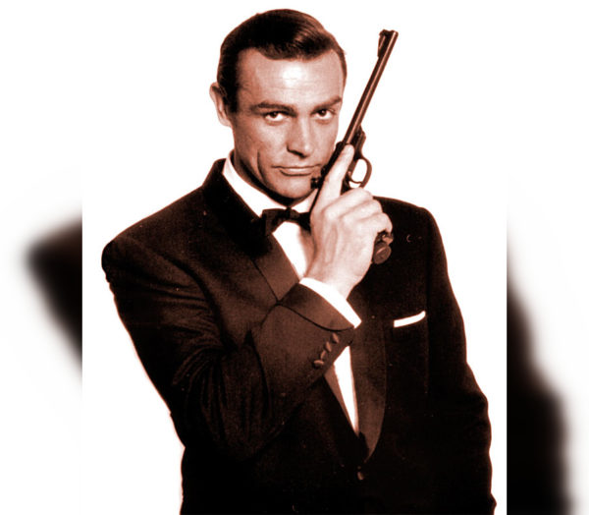
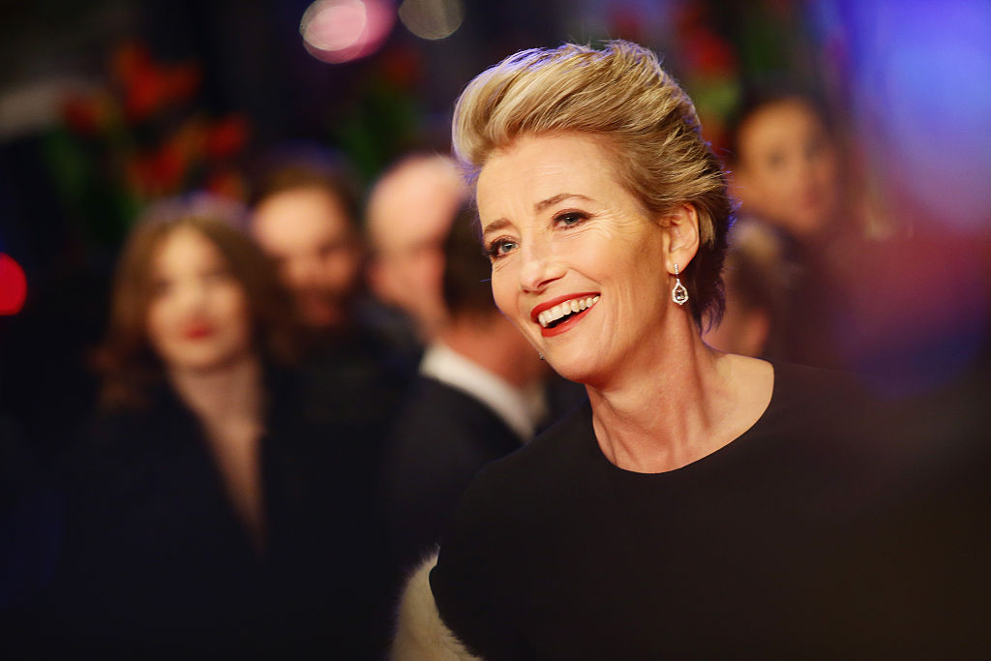
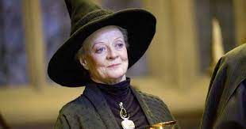
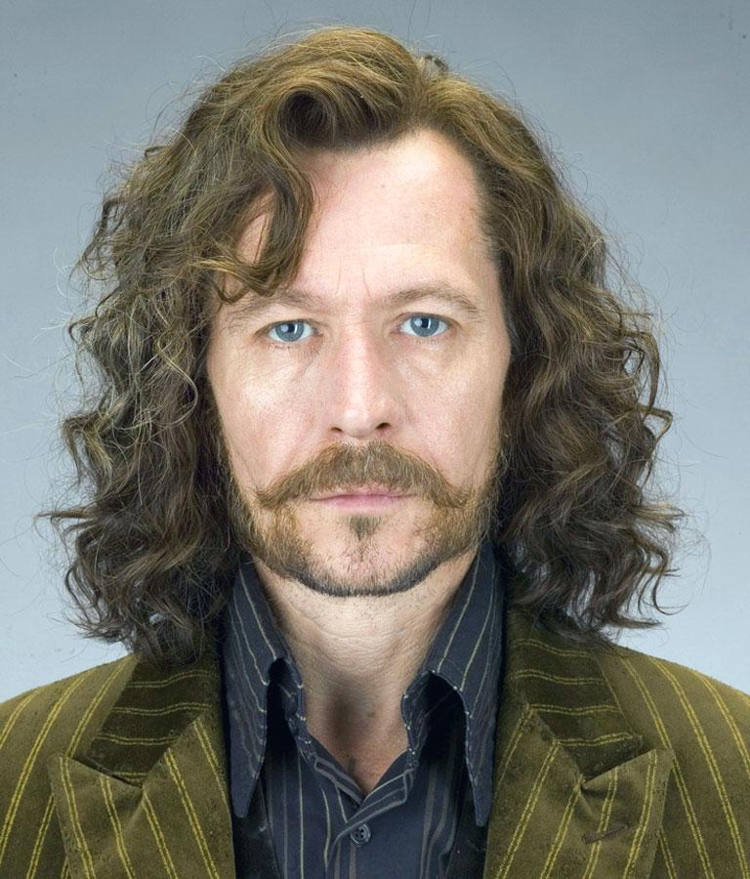
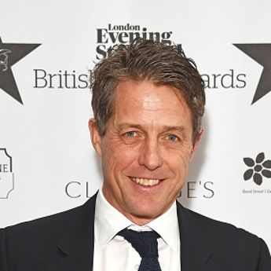
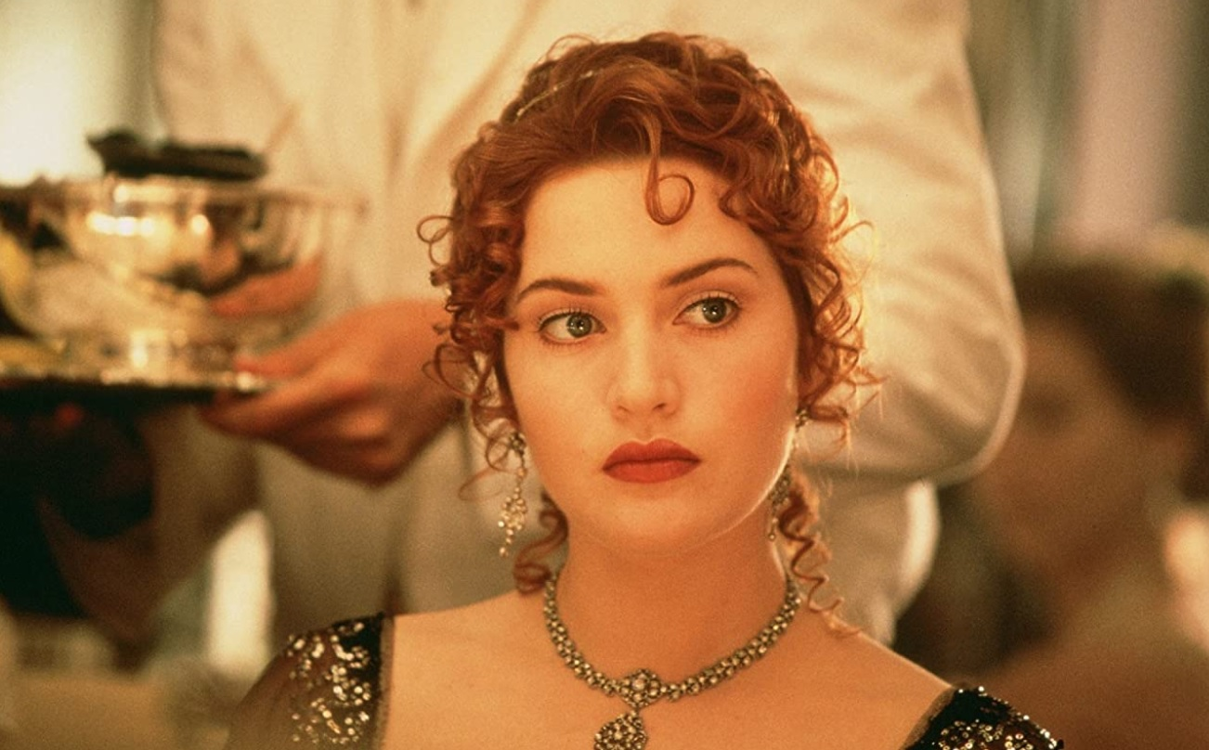

Slide 4
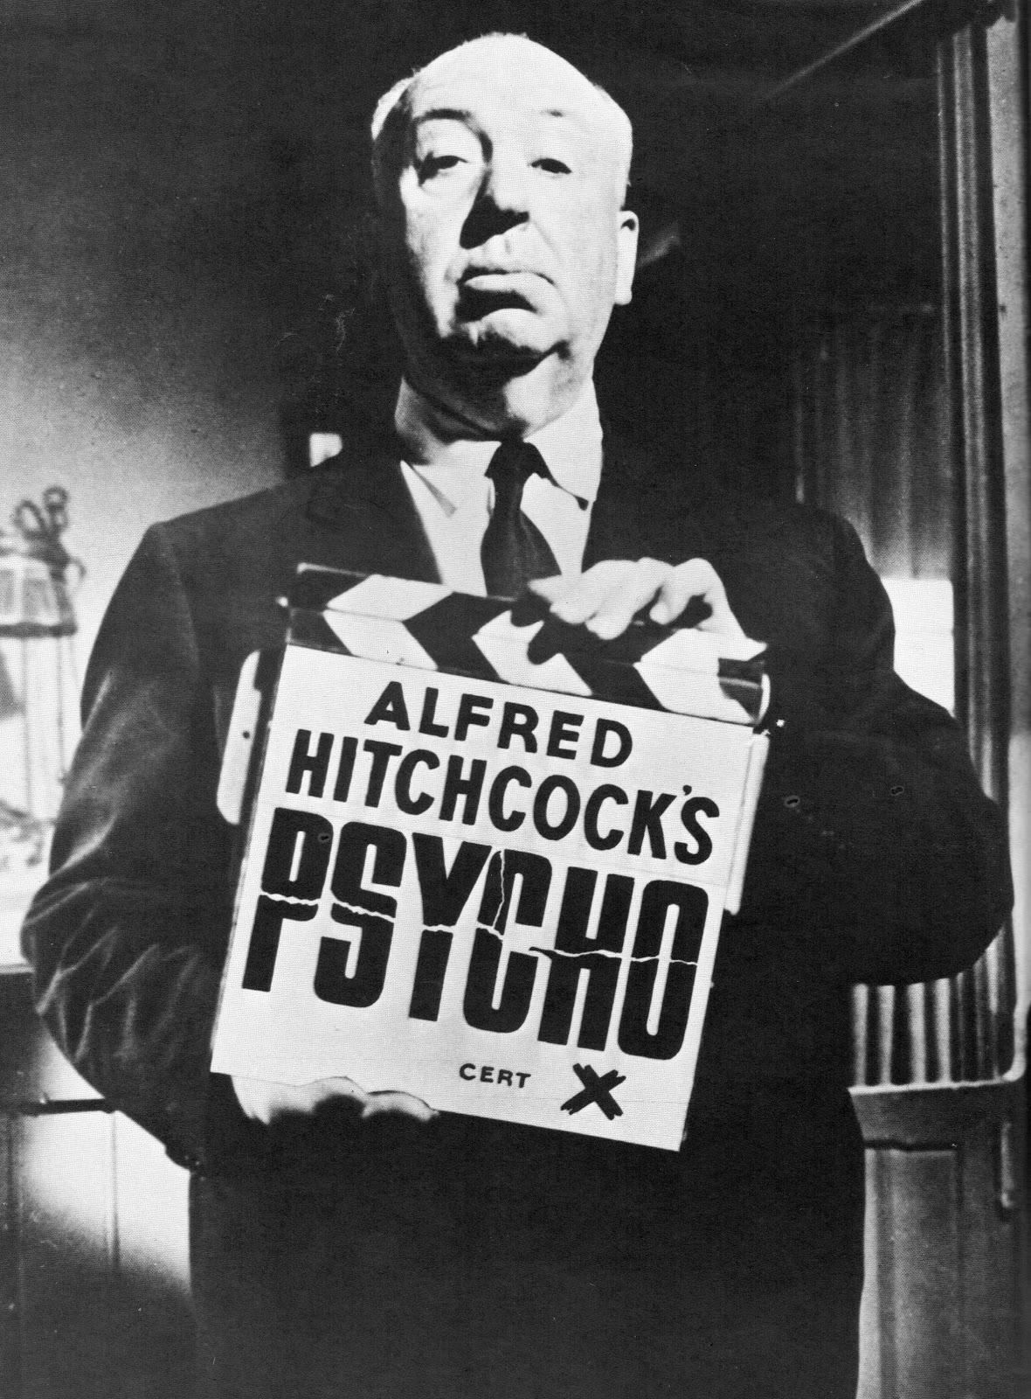
Silent films
The world's first moving picture was shot in Leeds by Louis Le Prince in 1888 and the first moving pictures were made in Hyde Park, London in 1889. The earliest British films were about everyday events. Later, in the early 20th century, comedies and melodramas became popular. The audience watched stories which they know like adaptations of Shakespeare plays and Dickens novels.
Alfred Hitchcock's Blackmail (1929), is often thought to be the first British film with sound. In the mid-1930s Alfred Hitchcock became so popular with thrillers that the British called him "Alfred the Great". Hitchcock's reputation was beginning to develop overseas and was signed up to a seven-year contract and moved to Hollywood.

Slide 5
During the 1950s, the British industry began to concentrate on popular comedies and World War II dramas often based on true stories. Rules for film production became less strict in the 1960s. In those times commercially successful horror films appeared. The Curse of Frankenstein (1957) and Dracula (1958) were the first gothic horror films in colour.
Some British studios were financed by the United States productions like the original Star Wars (1977), Superman (1978), and Alien (1979). Also successful adaptations of the Agatha Christie novels Murder on the Orient Express (1974) and Death on the Nile (1978) were made.
In the 1980s and 1990s a lot of films were produced on the British studios but with American investments
American producers increasingly invested in UK-based film production including films such as Interview with the Vampire (1994), Mission: Impossible (1996), Saving Private Ryan (1998), Star Wars: Episode I – The Phantom Menace (1999) and The Mummy (1999).
The first decade of the 21st century was successful for the British film industry. Many British films found a wide international audience due to good funding. For expample, a romantic comedy Bridget Jones's Diary (2001) grossed $254 million worldwide; Love Actually (2003) grossed $239 million. The most successful of all, Mamma Mia! (2008), grossed $601 million.
The new decade was also started with a major new film series in the Harry Potter films, beginning with Harry Potter and the Philosopher's Stone in 2001. Seven sequels (with the final title released in two parts – Harry Potter and the Deathly Hallows – Part 1 in 2010 and Harry Potter and the Deathly Hallows – Part 2 in 2011) all were filmed in England.

Slide 6
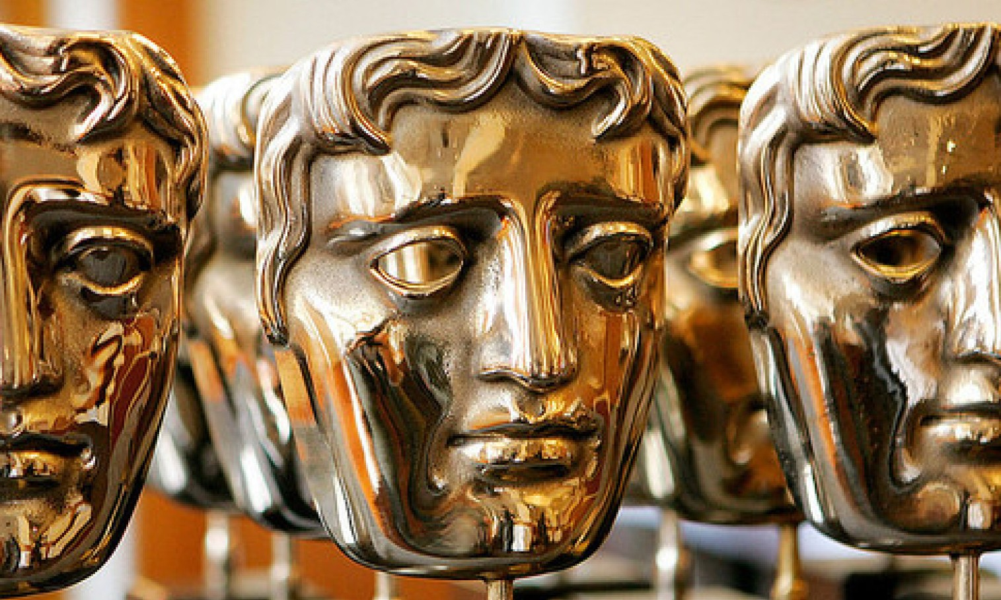
British Academy Film Awards
The British Academy Film Awards, more commonly known as the BAFTA Film Awards (the British Academy of Film and Television Arts)is an annual award show to honour the best British and international contributions to film.
The ceremonies were initially held at the Odeon cinema in London, then at the Royal Opera House from 2008 to 2016. Since 2017, the ceremony has been held at the Royal Albert Hall in London. The statue awarded to recipients depicts a theatrical mask.
The first BAFTA Awards ceremony was held in 1949.
The ceremony was first broadcast on the BBC in 1956.
The ceremony was initially held in April or May; since 2001, it typically takes place in February.

