Slide 1
History of the Olympic Games
Oksana Dzhur

Slide 2
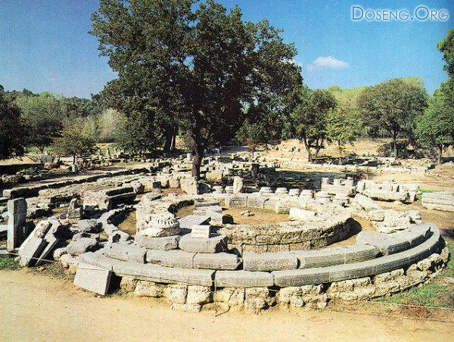
Beginning in 776 BC, the Olympic Games were held in the Valley of Olympia in Greece.

Slide 3
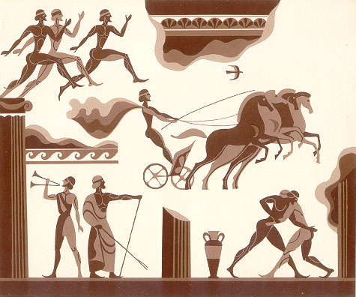
They were dedicated to the Olympian Gods and took place every four years. Sportsmen competed in running, wrestling, jumping, throwing the discus and throwing the javelin. In time boxing, a chariot race, and other events were included.

Slide 4
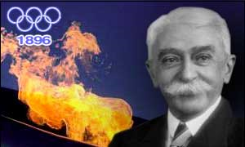
Baron Pierre de Coubertin is the organizer of the Modern Olympic Games.
The Modern Olympic Games took place in Greece in 1896. Almost 300 athletes from 13 countries participated in 9 different sports.

Slide 5
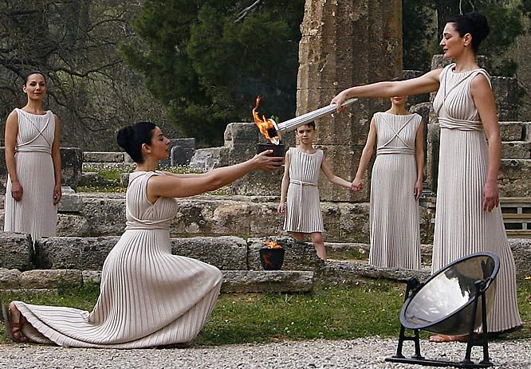
The Olympic Flame
It was lit during the ancient Olympic Games and it has been lit since the opening ceremony of the Olympic Games at Amsterdam, Netherlands in 1928.

Slide 6
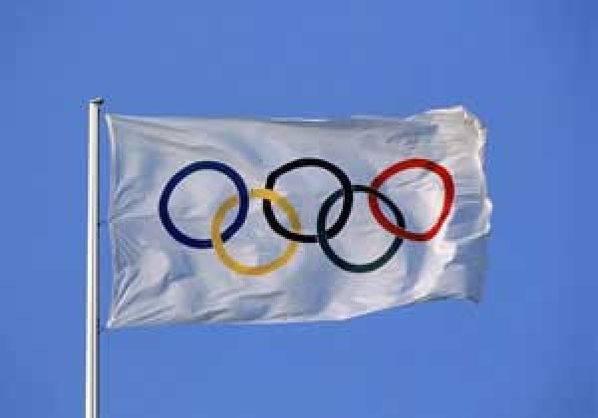
The Olympic Flag is the symbol of the Olympic Games (1920). Five rings on the white field represent the union of the five continents: blue (Europe), yellow (Asia), black (Africa), green (Australia), red (America).

Slide 7
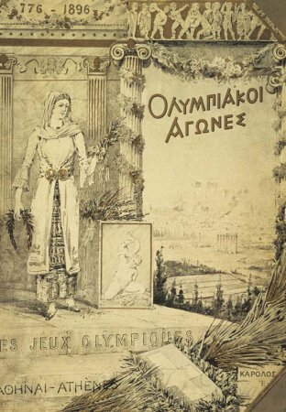
The Olympic Motto
Citius, Altius, Fortius (1908)
Быстрее, Выше, Сильнее
Faster, Higher, Stronger

Slide 8
The oath of honor at the stadium in Olympia at the altar of Zeus
"On behalf of all the athletes I promise you that we will participate in these Games, respecting and observing the rules by which they are carried out, in the true sporting spirit, in the glory of sport and in the name of honor their teams."
"От имени всех спортсменов я обещаю, что мы будем участвовать в этих Играх, уважая и соблюдая правила, по которым они проводятся, в истинно спортивном духе, во славу спорта и во имя чести своих команд".
In the 2000 Olympics in Sydney for the first time in the text of the oath appeared the words of the use of doping in sport competitions.

Slide 9
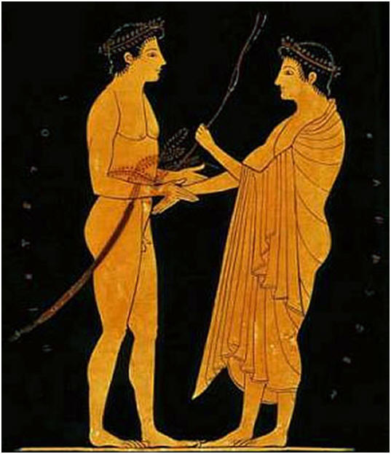
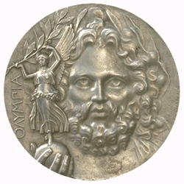
The victors of the early games were awarded with wreaths from the olive tree that was planted by Hercules ( Heracles), founder of the Games.

Slide 10
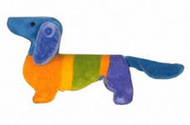
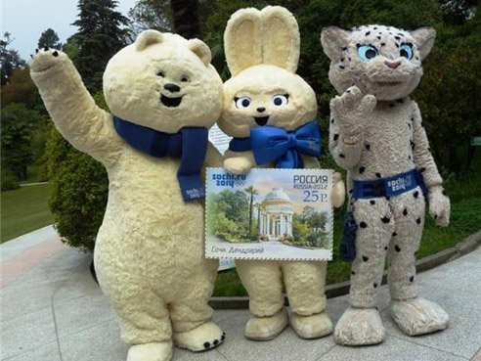
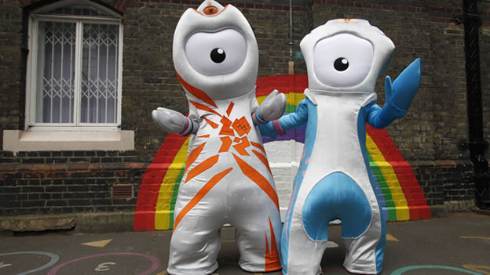
Olympic Mascots
Olympic Mascots of London
First it appeared at the 1972 Munich Olympic Games. It was Waldi, the dachshund. Since that time it has been one of the symbols of the Olympics. It shows the geographical features, history and culture of the host city.

Slide 11
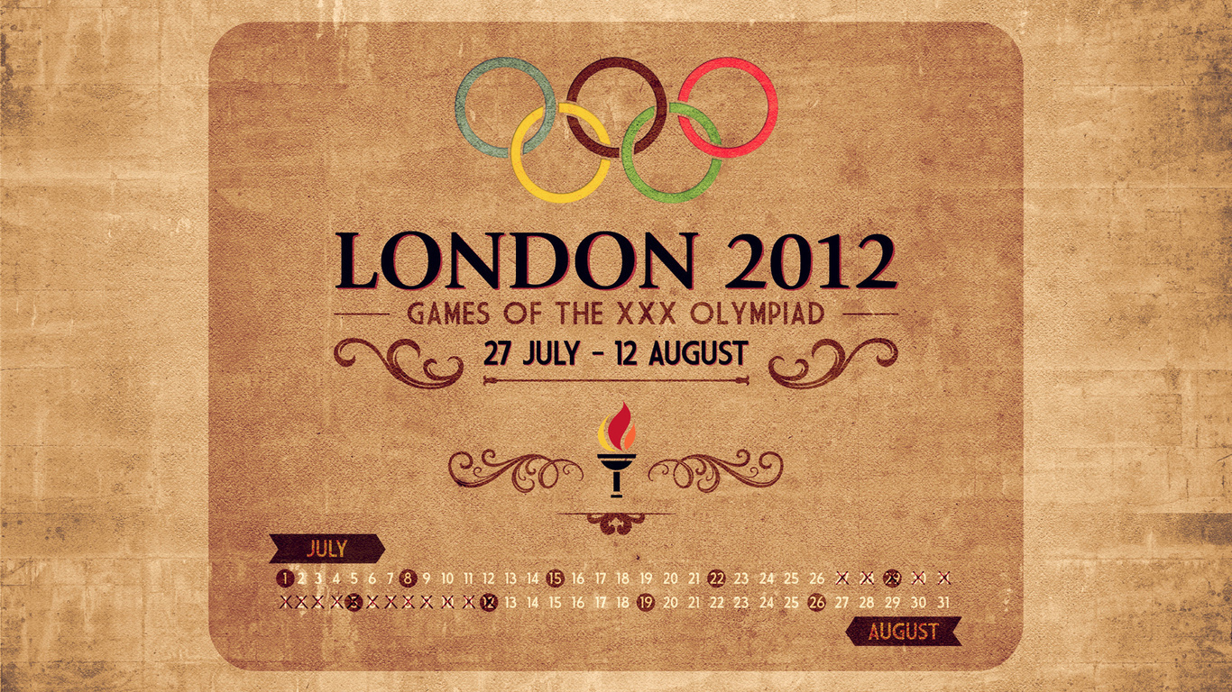
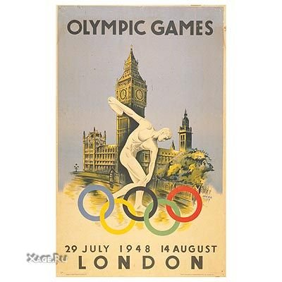
The latest 30-th Olympic Games took place in London in 2012. Athletes from 204 countries competed in 37 different sports.
The 14-th Olympic Games took place in London in 1948. Athletes from 59 countries participated in 9 sports.

Slide 12
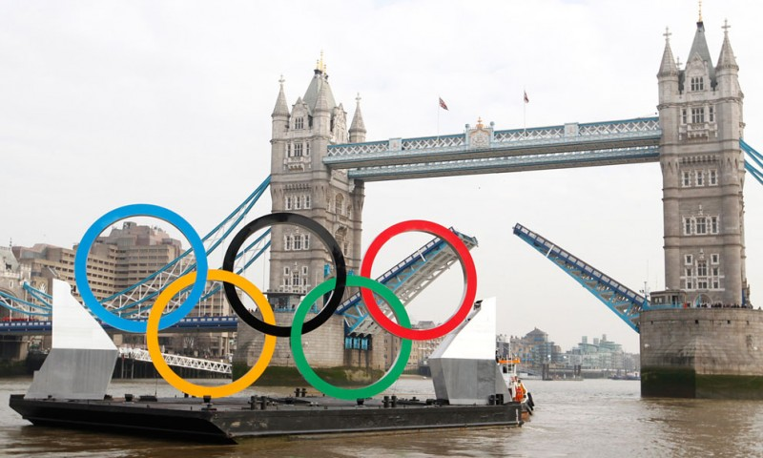
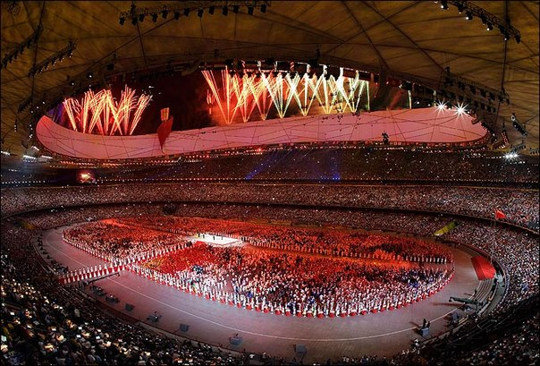
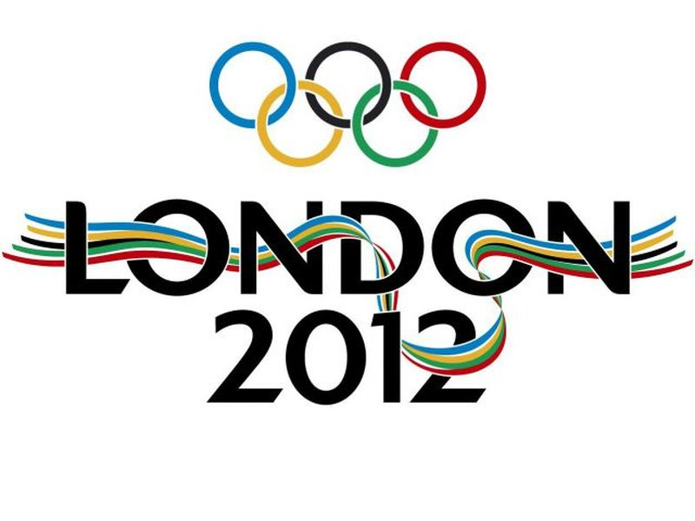
The 30-th Olympic Games

Slide 13

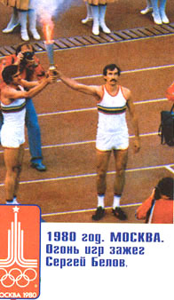
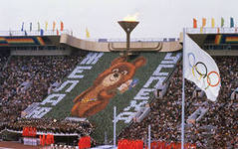
Moscow - 80
More than 5000 athletes from 80 countries competed in 21 different sports.

Slide 14
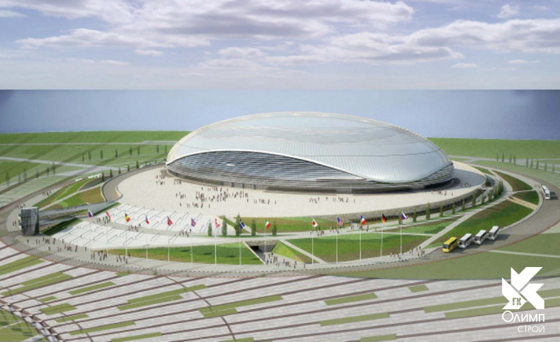
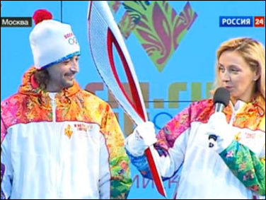
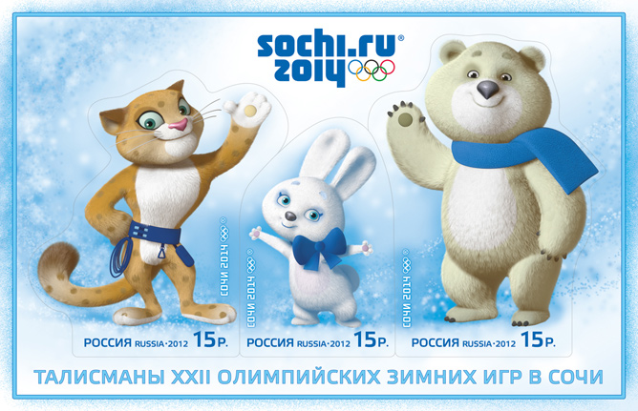
Sochy-2014

Slide 15
Welcome to Olympic Games

