Slide 1
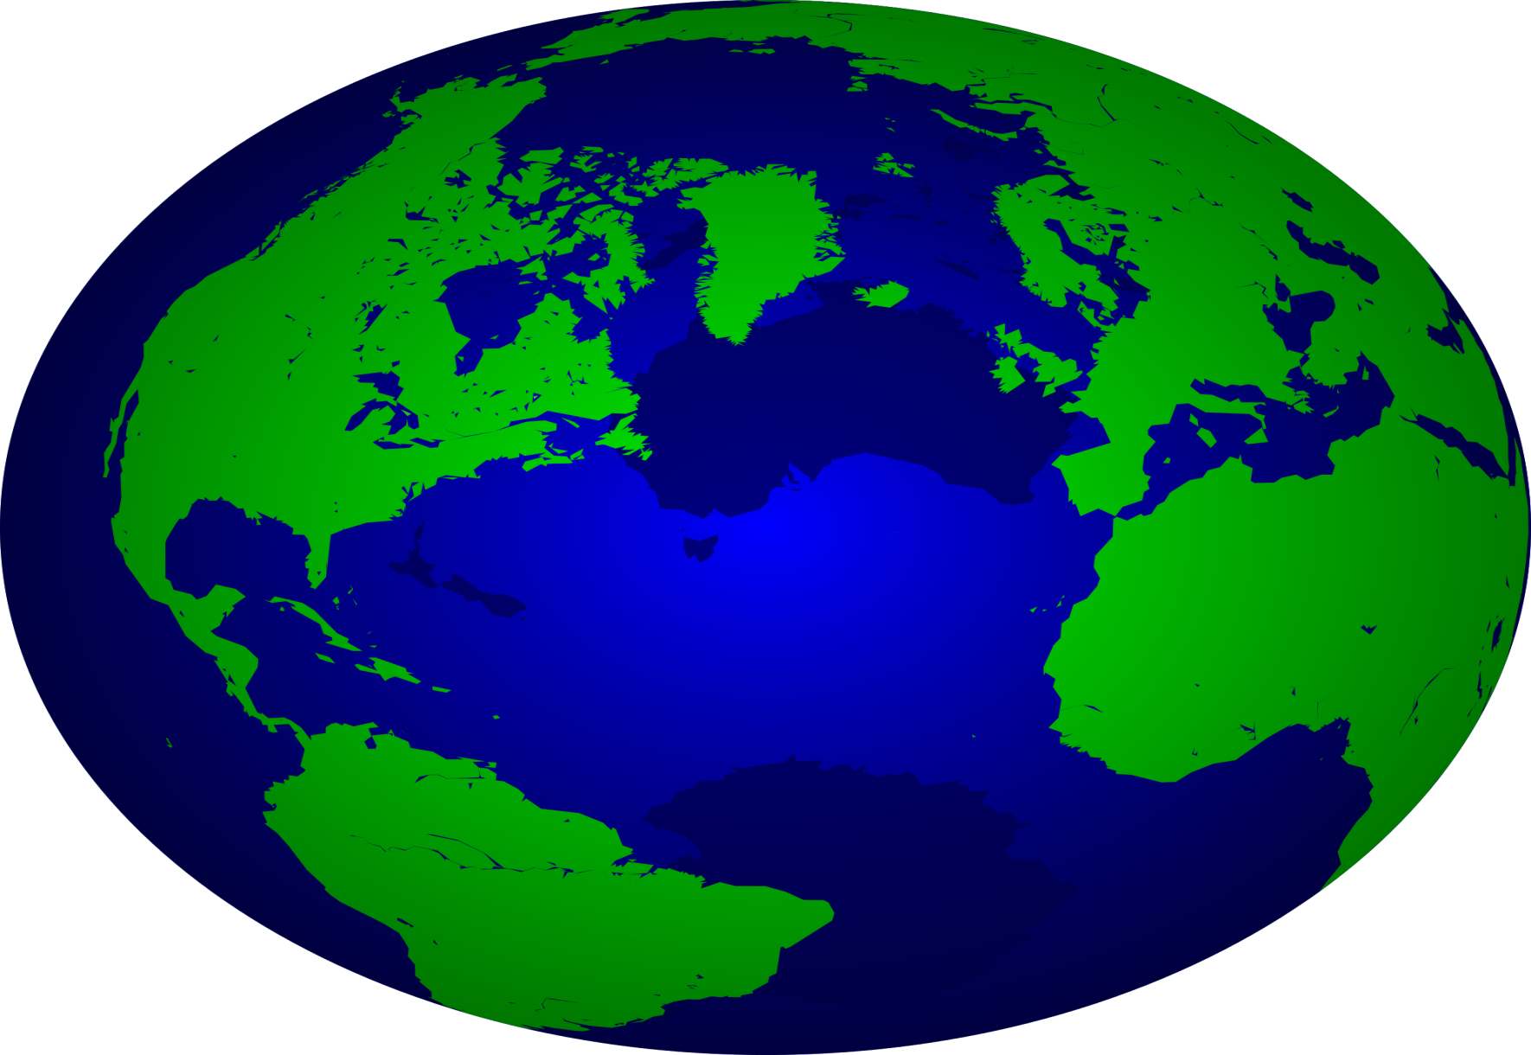
The ENVIRONMENTAL PROBLEMS of our PLANET

Slide 2

“To take care of the planet is to take care of our own house.”
The Dalai Lama

Slide 3
I want to live and not to die
I want to laugh and not to cry
I want to feel the summer sun
I want to sing when life is fun
I want to fly into the blue I want to swim as fishes do
I want to stretch out friendly hands
To all the young of other lands
I want to live and not die
I want to laugh and not to cry
I want to mate, No atom bomb
Annihilate,
My shining world!

Slide 4
Let’s combine the parts. Complete the definition.
Pollution | the contamination of the environment.
Litter, trash, waste, rubbish, garbage | things that you throw away, such as empty bottles, used papers, food that has gone bad etc.
Air pollution | the condition in which air is contaminated by foreign substances, or the substances themselves.
Water pollution | the contamination of water bodies (lakes, rivers and others).
Deforestation | the cutting or burning down of all the trees in an area.
Recycle | make new things from different kinds of litter.
Reduce | to limit, not to use very often.
Reuse | to use once more.

Slide 5
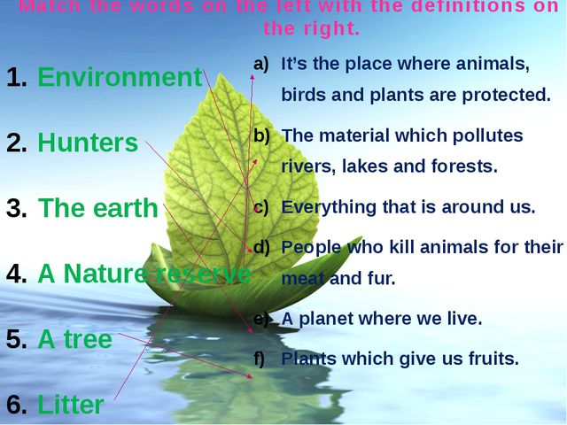

Slide 6
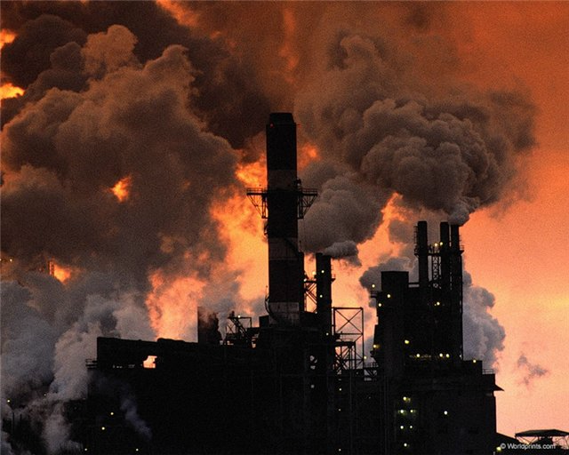
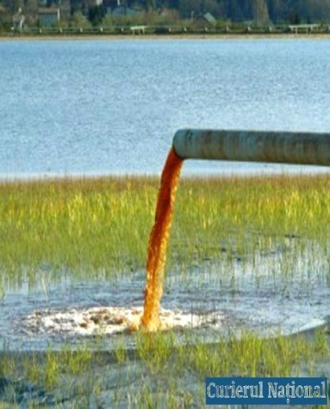
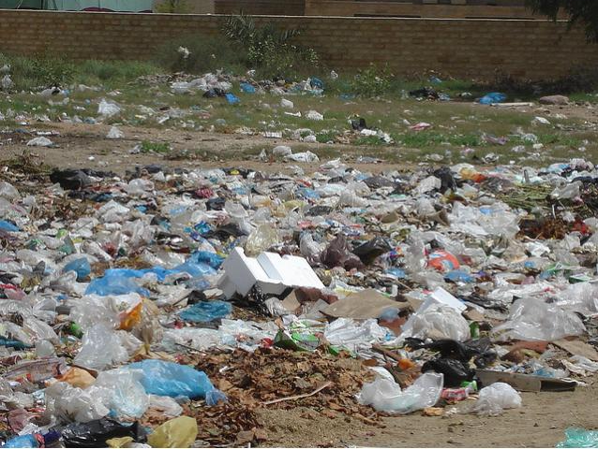
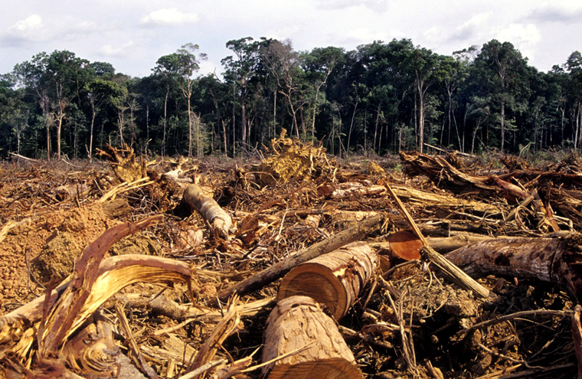
The biggest environmental problem in my region is … .
I think … is the reason for …
There are things people should do to solve the problem.
For example, … .
Example: I think air pollution is typical of big Ukrainian cities where there are many big plants and factories.

Slide 7
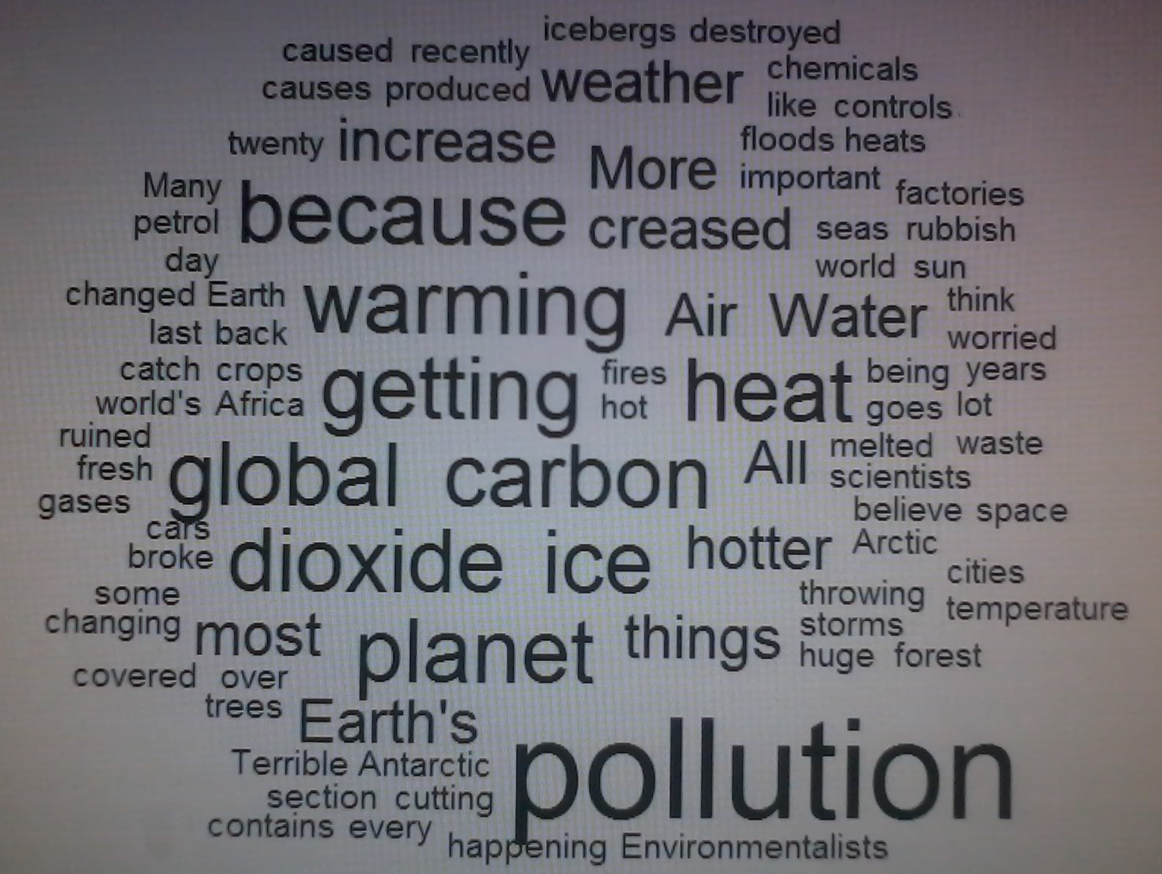

Slide 8
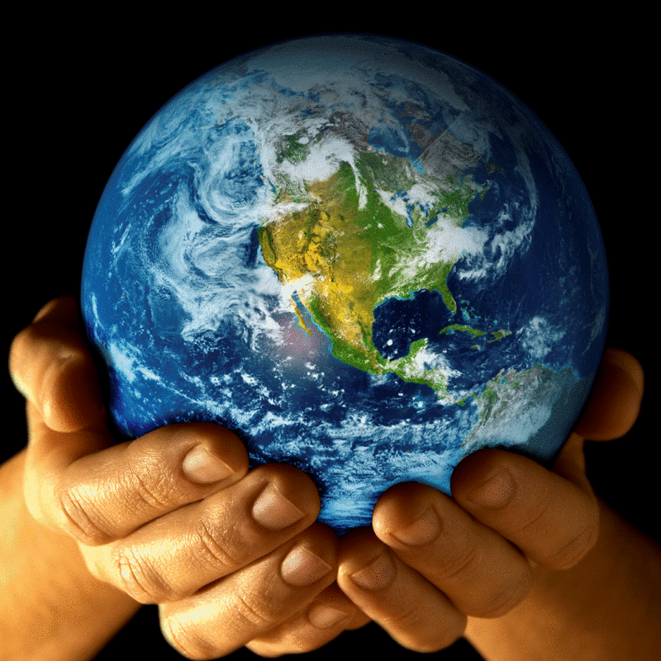
Reading “We can help our planet”

Slide 9
Writing: “The threat to the environment”
Nowadays people are more aware that wildlife all over the world is in (1)….many (2)… of animals are threatened, and could easily become(3)… if we do not make an effort to (4)…them. There are many reasons for this. In some cases, animals are (5)…for their fur or for other valuable parts of their bodies. Some birds, (6)…as parrots, are caught (7)… , and sold as pets. For many animals and birds, the problem is their habitat, the (8)… where they live, is (9)… . More (10)…is used for farms, for houses or industry, and there are fewer open (11)…than there once were. Farmers use powerful chemicals to help them grow better (12)…, but these chemicals pollute the environment and (13)… wildlife.
1. a) danger b) threat c) problem d) vanishing
2. a) marks b) more c) species d) forms
3. a) disappeared b) vanished c)empty d) extinct
4. a) harm b) safe c) protect d) serve
5. a) hunted b) chased c) game d) extinct
6. a) like b) such c) or d) where
7. a) lively b) alive c) for life d) for living
8. a) spot b) point c) place d)site
9. a) exhausting b) departing c)escaping d) disappearing
10.a) each b) land c) soil d) area
11. a) spaces b) air c) up d) parts
12. a) products b) fields c) herbs d) crops
13. a) spoil b) harm c) wound d) wrong

Slide 10
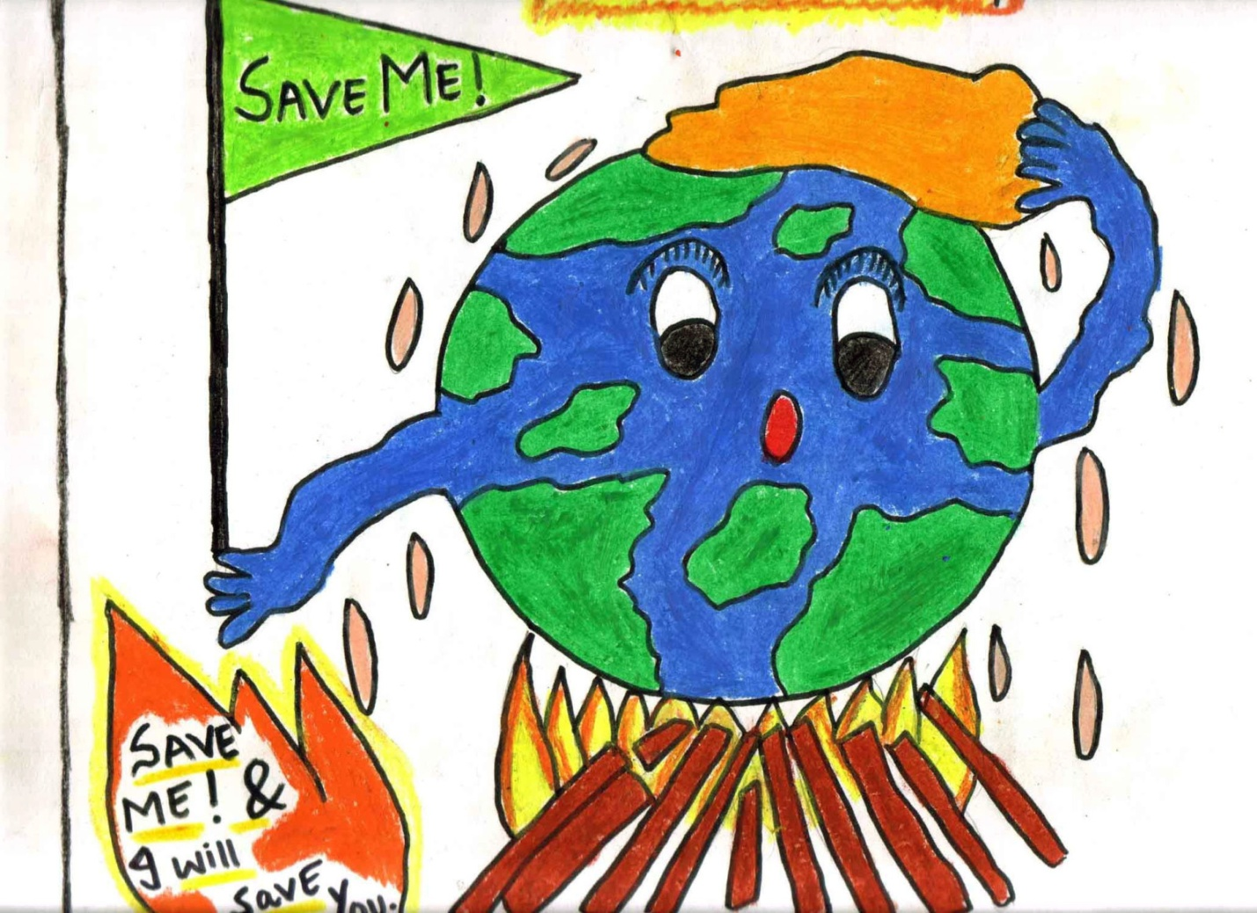
Listening:
“Mother Nature needs us”

Slide 11
Mother Nature needs us
person
If just one ………. ……………..shines
Others will follow in line
As we board the ……………. ……………..train
We’ll say good-bye to …………
As we fight …
We’ll stand united as one
All around the world
A new day has began
We’re so afraid of ……….
But we can find a brighter day
Let’s work on the …………..
So our children can play
In pure clean …………
And blue skies above
It’s not a fantasy
We’ll make it our reality
We’ve got to all come together
And start …...................the seed
Mother Nature needs us
We were blind but now we see
greenhouse
acid rain
global warming
pollution
solutions
water
… planting

Slide 12
Project work
Water pollution
Deforestation
Problems
Air pollution

Slide 13
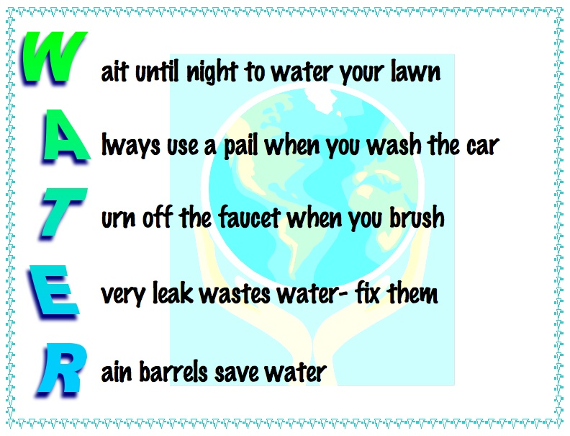

Slide 14
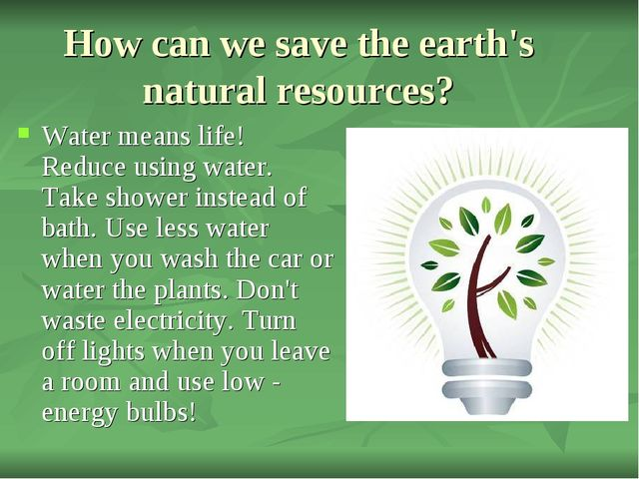

Slide 15
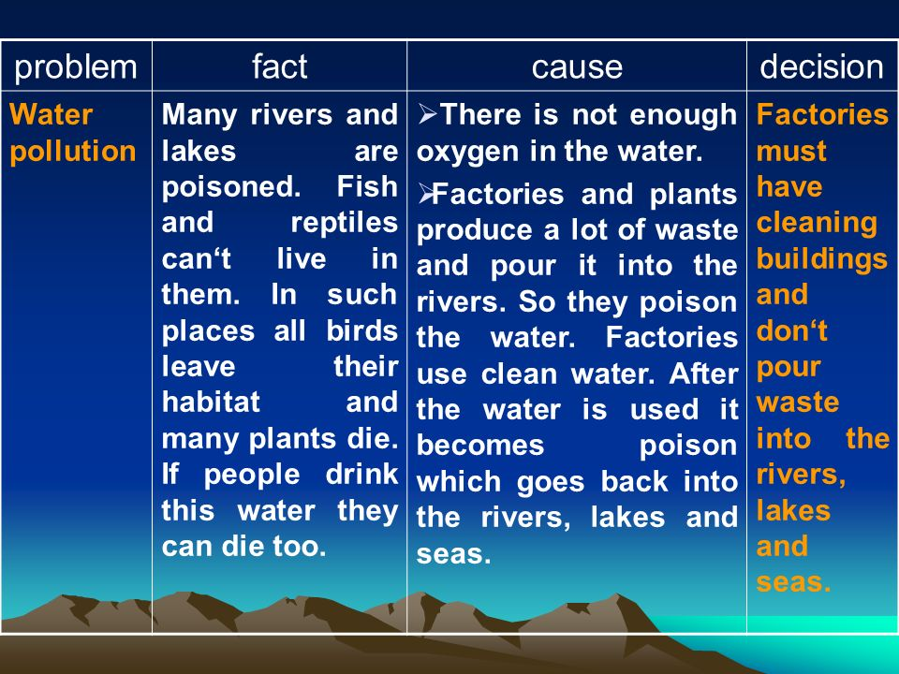

Slide 16
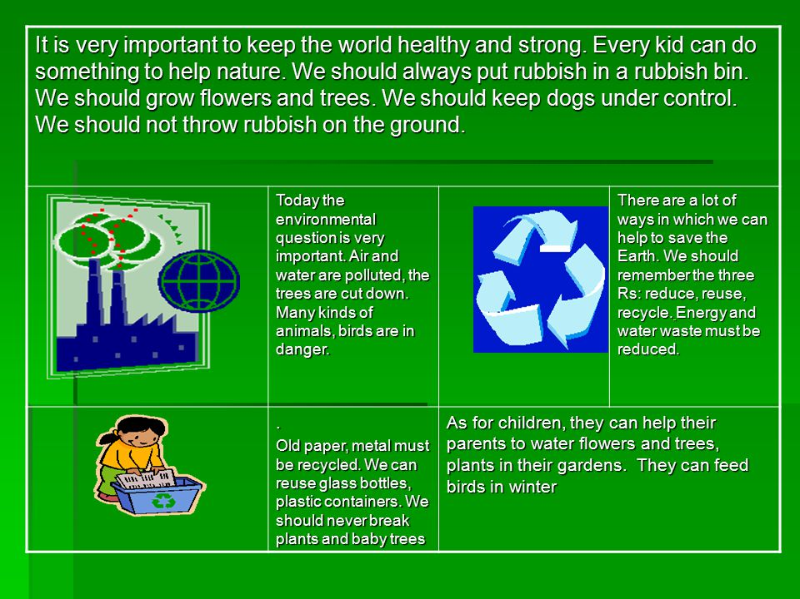

Slide 17
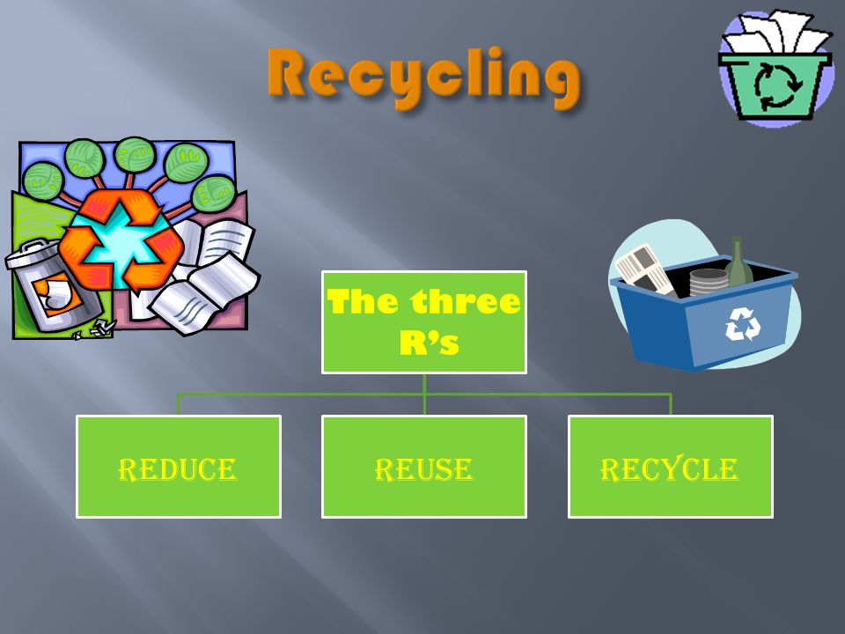

Slide 18
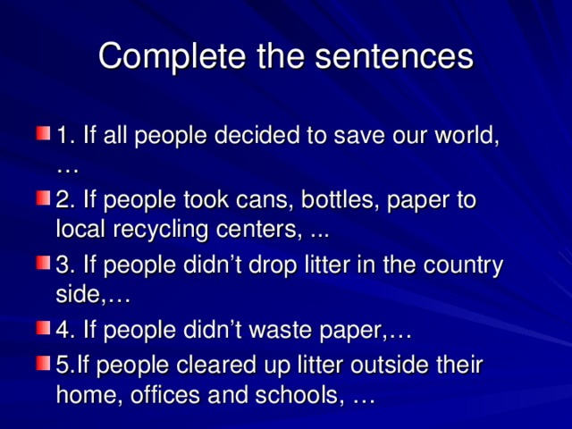

Slide 19
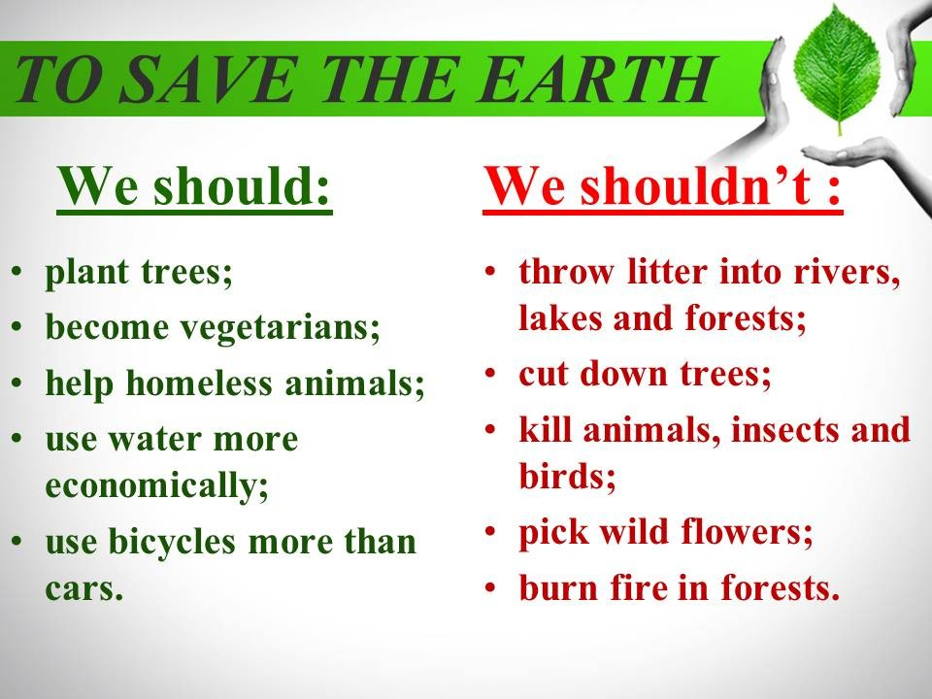

Slide 20
We do other activities:
we organize recycling pick-up days every Thursday in spring and autumn;
plant trees;
take care of birds in winter;
plant flowers in lawns;
we reduce water, light.

Slide 21
Have we gained our aims?
Can you speak about different environmental problems and the ways of their solving?
Do you know what we can do to save our planet?
Will you do everything you can to avoid the pollution on the local level?

Slide 22
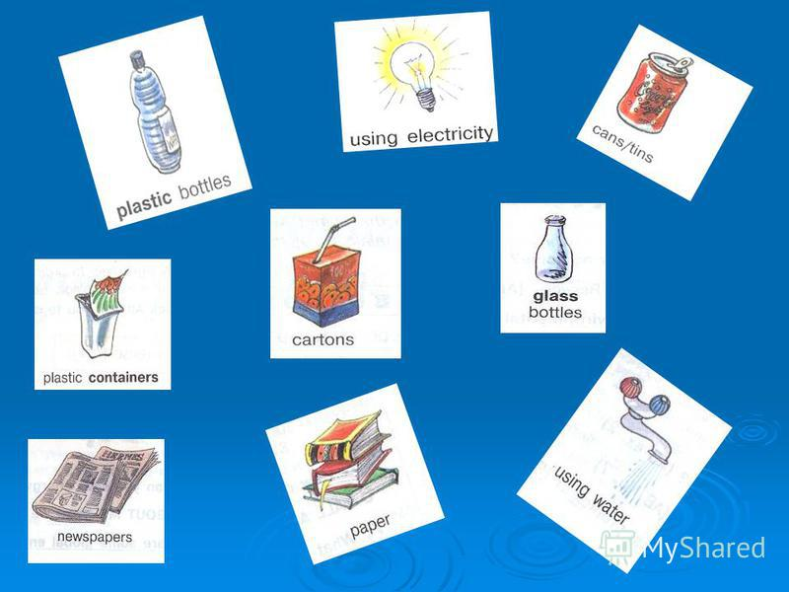
Hometask:
Write a letter
to your penfriend about
the biggest environmental problems
in your region.

Slide 23
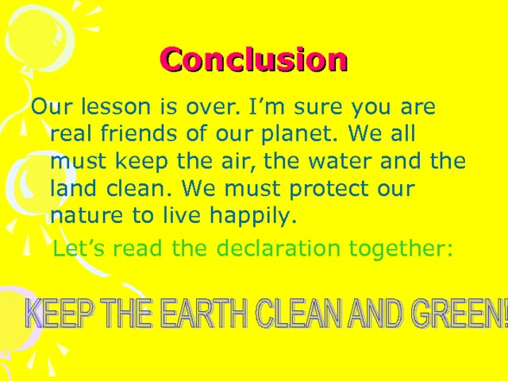

Slide 24
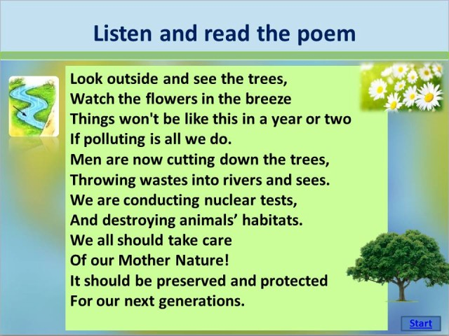

Slide 25


Slide 27
LET’S SAVE OUR EARTH

