Slide 1


Slide 2

HEALTH IS ABOVE WEALTH

Slide 3
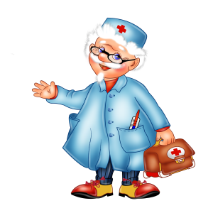
Stomach ache
Headache
Nurse
Earache
Backache
Dentist
Toothache
Medicine
Cold

Slide 4
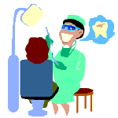

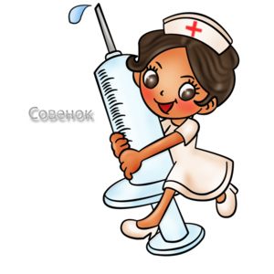
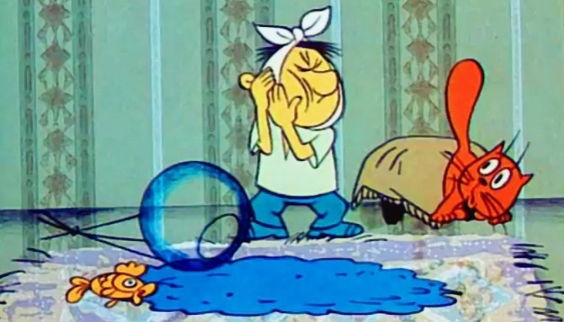
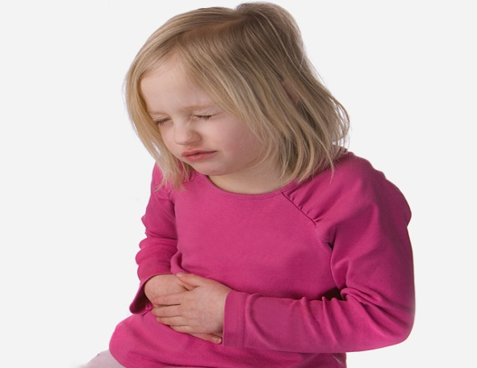
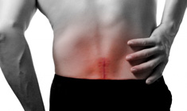
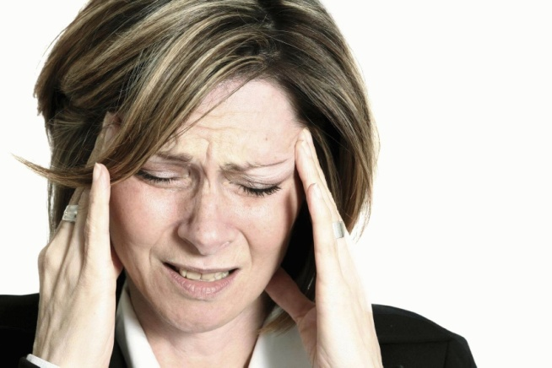
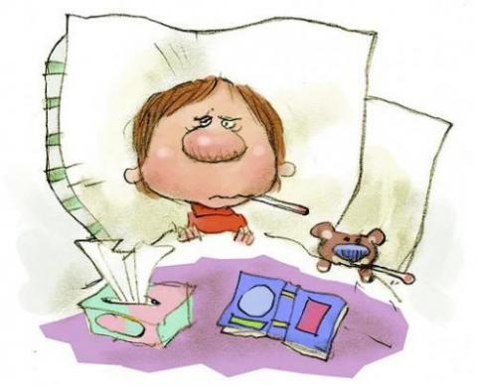
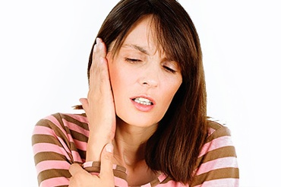

Slide 5
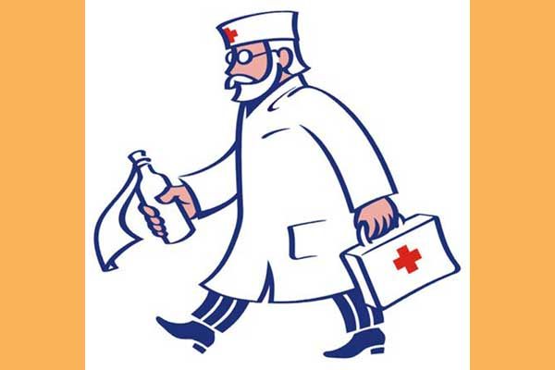
A rash pain
A bruise pulse
A cut disease
A cough lungs
A hay fever chest
A sore throat ankle
The flu wrist
To feel dizzy blood pressure

Slide 6
Match the words and their definitions.
1) a surgeon | a) looks after children and treats their illnesses
2) a sister | b) is trained to prepare drugs and medicines and works in a chemist’s or in a hospital
3) a dentist | c) examines and treats people’s eyes
4) a pediatrician | d) looks after patients in hospital
5) a nurse | e) looks after your heart
6) a general practitioner/a physician | f) is a senior nurse in a hospital
7) an oculist | g) examines and treats people’s ears
8) an ear doctor | h) does operations in hospital
9) cardiologist | i) is trained in general medicine and treats people in a particular area or town
10) a pharmacist | j) looks after your teeth

Slide 7
Pair work. Miming game
— What’s the matter?
— I’ve got a toothache.
— What are you going to do?
— I’m going to see a dentist.

Slide 8
Tick healthy problems that each child has. ( V )
 | cold | cough | Sore throat | Ear-ache | Head-ache | Tummy ache
Sue
Jane
Tom
Sophie

Slide 9
4. Reading and writing
Read the text and write out and translate the words and expressions which you’ve learnt at this lesson.
There is nothing more important than health. “Health is above wealth”, wise people say, because you can’t be good at your studies or work well if you don’t take care of your health.
If you complain of a sore throat or a bad cough, if you run a high temperature and have a bad cold, if you have a headache, heart disease, toothache, backache, earache or a bad pain in the stomach, if you suffer from a high or low blood pressure, you should consult a doctor.
The doctor will take your temperature, examine you, feel your pulse, test your blood pressure, sound your heart and lungs and have your chest X-rayed if necessary. After that he will prescribe you some treatment (pills, tablets, mixtures or some other medicine) which you can buy at the chemist’s. In order to avoid complications he will recommend you to stay in bed for some days. If you want to recover soon, you have to follow the doctor’s instructions.

Slide 10
