Slide 1





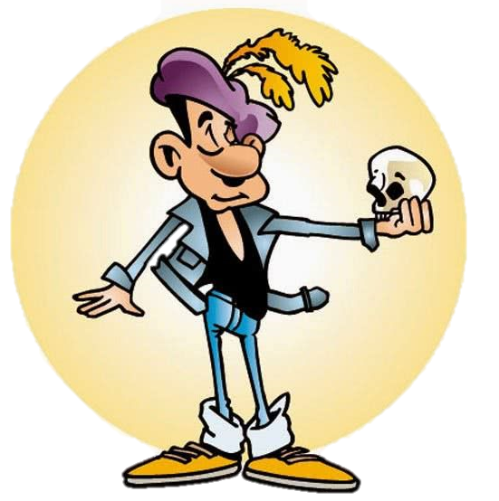
Doct..
Tail..
Driv..
Bank ..
Sail..
Act..

