Slide 1
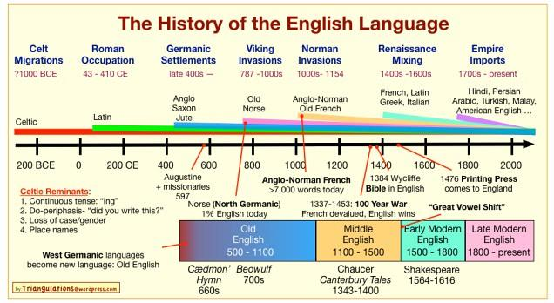

Slide 2
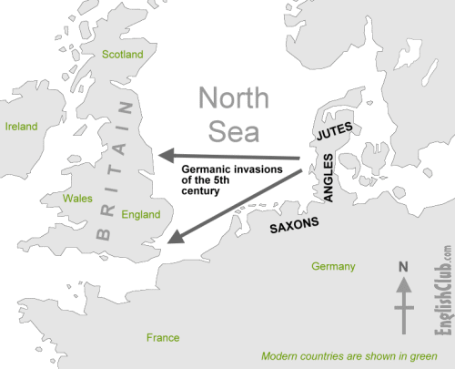
History of English
The history of the English language really started with the arrival of three Germanic tribes who invaded Britain during the 5th century AD. These tribes, the Angles, the Saxons and the Jutes, crossed the North Sea from what today is Denmark and northern Germany. At that time the inhabitants of Britain spoke a Celtic language. But most of the Celtic speakers were pushed west and north by the invaders - mainly into what is now Wales, Scotland and Ireland. The Angles came from "Englaland" [sic] and their language was called "Englisc" - from which the words "England" and "English" are derived.

Slide 3
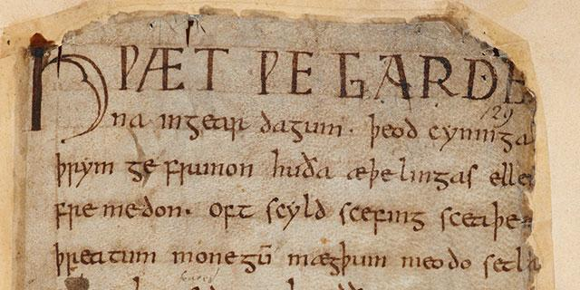
Old English (450-1100 AD)
The invading Germanic tribes spoke similar languages, which in Britain developed into what we now call Old English. Old English did not sound or look like English today. Native English speakers now would have great difficulty understanding Old English. Nevertheless, about half of the most commonly used words in Modern English have Old English roots. The words be, strong and water, for example, derive from Old English. Old English was spoken until around 1100.
Part of Beowulf, a poem written in Old English

Slide 4
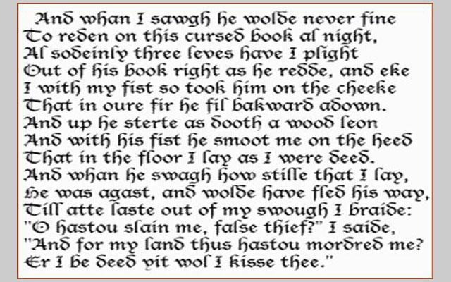
Middle English (1100-1500)
In 1066 William the Conqueror, the Duke of Normandy (part of modern France), invaded and conquered England. The new conquerors (called the Normans) brought with them a kind of French, which became the language of the Royal Court, and the ruling and business classes. For a period there was a kind of linguistic class division, where the lower classes spoke English and the upper classes spoke French. In the 14th century English became dominant in Britain again, but with many French words added. This language is called Middle English. It was the language of the great poet Chaucer (c1340-1400), but it would still be difficult for native English speakers to understand today.
An example of Middle English by Chaucer

Slide 5
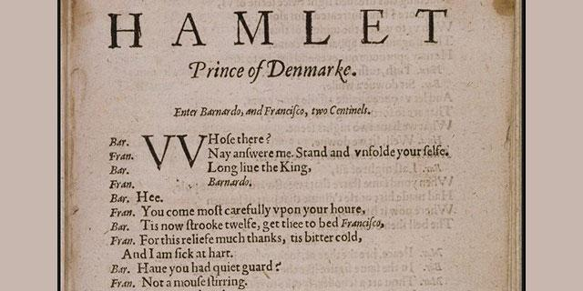
Modern English: Early Modern English (1500-1800)
Towards the end of Middle English, a sudden and distinct change in pronunciation (the Great Vowel Shift) started, with vowels being pronounced shorter and shorter. From the 16th century the British had contact with many peoples from around the world.
This, and the Renaissance of Classical learning, meant that many new words and phrases entered the language. The invention of printing also meant that there was now a common language in print. Books became cheaper and more people learned to read. Printing also brought standardization to English. Spelling and grammar became fixed, and the dialect of London, where most publishing houses were, became the standard. In 1604 the first English dictionary was published.
Lines from Hamlet, written in Early Modern English by Shakespeare

Slide 6
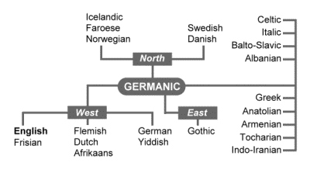
Late Modern English (1800-Present)
The main difference between Early Modern English and Late Modern English is vocabulary. Late Modern English has many more words, arising from two principal factors: firstly, the Industrial Revolution and technology created a need for new words; secondly, the British Empire at its height covered one quarter of the earth's surface, and the English language adopted foreign words from many countries.
English is a member of the Germanic family of languages. Germanic is a branch of the Indo-European language family.

Slide 7
A brief chronology of English
Local inhabitants speak Celtish:
55 BC Roman invasion of Britain by Julius Caesar
AD 43 Roman invasion and occupation. Beginning of Roman rule of Britain
436 Roman withdrawal from Britain complete
449 Settlement of Britain by Germanic invaders begins
Old English:
450-480 Earliest known Old English inscriptions
1066 William the Conqueror, Duke of Normandy, invades and conquers England
Middle English:
c1150 Earliest surviving manuscripts in Middle English
1348 English replaces Latin as the language of instruction in most schools
1362 English replaces French as the language of law. English is used in Parliament for the first time
c1388 Chaucer starts writing The Canterbury Tales
c1400 The Great Vowel Shift begins

Slide 8
Early Modern English:
1476 William Caxton establishes the first English printing press
1564 Shakespeare is born
1604 Table Alphabeticall, the first English dictionary, is published
1607 The first permanent English settlement in the New World (Jamestown) is established
1616 Shakespeare dies
1623 Shakespeare's First Folio is published
1702 The first daily English-language newspaper, The Daily Courant, is published in London
1755 Samuel Johnson publishes his English dictionary
1776 Thomas Jefferson writes the American Declaration of Independence
1782 Britain abandons its colonies in what is later to become the USA
Late Modern English
1828 Webster publishes his American English dictionary
1922 The British Broadcasting Corporation is founded
1928 The Oxford English Dictionary is published

Slide 9


Slide 10
