Slide 1

What are the most complete definitions of the words “mass media” and “newspaper”?
Mass media is a means of public communication reaching a large audience.
Mass media is the means of communication that reach large numbers of people in a short time, such as television, newspapers, magazines, and radio.
A newspaper is a regularly printed document consisting of large sheets of paper that are folded together, or a website, containing news reports, articles, photographs, and advertisements.
A newspaper is a paper that is printed and distributed usually daily or weekly and that contains news, articles of opinion, features, and advertising.

Slide 2

Popular newspapers in Great Britain

Slide 3
The Media in Great Britain
The media play a central role in Britain’s daily life, informing and educating, questioning and challenging, and of course, entertaining. The Internet is providing, increasingly, an additional medium for information, entertainment and communication. Mass media are tools for the transfer of information, concepts, and ideas to both general and specific audiences. The media are major transmitters of culture. Media of Great Britain consist of several different types of communications media: television, radio, newspapers, magazines, and Web sites.
The Press in Great Britain
Newspaper readership had been in long-term decline over a 40-year period, but the UK remained one of the nations with the most avid newspaper readers. The London-based national press predominated. The British press is one of the most free in the world. According to Brian McNair, 80 percent of adults regularly read at least one national daily newspaper (not necessarily every day), and 75 percent read a Sunday edition. England’s first news periodicals, called corantos, circulated in the 1620s. There are about 130 daily and Sunday newspapers, over 2,000 weekly newspapers and some 7,000 periodical publications in Britain. The UK’s national daily newspapers are commonly identified as either “quality” (that is, publishing serious, news-led journalism) or “tabloid” (devoted more to populist and celebrity/royal gossip). On the quality side are the Guardian,Times and Conservative Daily Telegraph, along with the business-minded Financial Times. All are outsold by the tabloids, led by the Sun and Daily Mirror, along with the frequently xenophobic Daily Mail and Daily Express. All of these appear Monday to Saturday only. On Sundays, each gives way to a sister title from the same stable. Most are identifiable (i.e. Sunday Times, Independent on Sunday and so on), though the Guardian becomes the Observer – England’s oldest Sunday newspaper – and the Sun changes into the News of the World. The most influential newspapers are the Times, the Daily Telegraph and the Guardian.

Slide 4
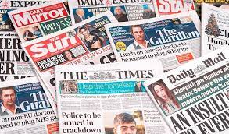
The Times, a British daily national newspaper, was founded by John Walter in London in 1785 under the title The Daily Universal Register (it became The Times on 1 January 1788). Since the early 19th century it has been the most prestigious British newspaper. It developed a reputation for independence, truthfulness, and forcefulness. More than any other paper, it can be considered a national institution, and is for many the “paper of record”.
The Daily Telegraph, founded in 1855 as The Daily Telegraph and Courier after the repeal of the stamp tax, quickly became Britain’s best-selling paper, with its mix of sport and politics and its peerless news service. Following a decline in the early 20th century, it emerged in the 1930s as the upmarket leader, a position it retained in in the early 2000s.
The Guardian began as a provincial paper, the Manchester Guardian. During the 19th century and particularly under the editorship of Charles Scott, it became associated with the left wing of the Liberal Party. Its willingness to take unpopular stands, sometimes at great financial cost, earned it many admirers. Among the national broadsheets, it alone consistently supported the Labour Party during the period of Conservative dominance before the 1990s.

Slide 5
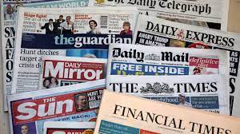
The provincial press (regional and local) contains mainly local news. The most popular are newspapers of Scotland: The Daily Record, which is called “half Scottish Daily Mirror half a genuinely separate Glasgow paper”, and a well-respected daily broadsheet, the Scotsman.
The Sun is a daily tabloid newspaper published in the United Kingdom and Ireland. Founded in 1964 as a successor broadsheet to the Daily Herald, it became a tabloid in 1969 after it was purchased by its current owners. The Sun is the most successful and best loved newspaper, read by more than seven million readers in the UK every day. Regional editions of the newspaper for Scotland, Northern Ireland and the Republic of Ireland are published in Glasgow (The Scottish Sun), Belfast (The Sun) and Dublin (The Irish Sun) respectively.
The Daily Mirror is a British national daily tabloid newspaper founded in 1903 as a newspaper for women. Twice in its history, from 1985 to 1987, and from 1997 to 2002, the title on its masthead was simply The Mirror. Its Sunday sister paper is the Sunday Mirror. It began life in 1915 as the Sunday Pictorial and changed to become the Sunday Mirror in 1963.
More info: https://www.oxford-royale.com/articles/a-guide-to-british-newspapers/

Slide 6

Top 10 U.K. Newspapers by Circulation
1. The Sun. A tabloid newspaper founded in 1964 and published in the United Kingdom and Ireland. thesun.co.uk
2. Metro. Metro is the United Kingdom’s highest-circulation print newspaper. metro.co.uk.
3. The Sun on Sunday. The Sun on Sunday was launched to replace the defunct News of the World. thesun.co.uk
4. Daily Mail. A daily middle-market tabloid newspaper published in London. dailymail.co.uk.
5. Mail on Sunday Launched in 1982 as a sister paper to the Daily Mail, it’s a conservative newspaper published in a tabloid format. dailymail.co.uk/mailonsunday.
6. The Sunday Times The largest-selling British national newspaper in the “quality press” market category. thetimes.co.uk7. News – London Evening Standard All the latest news in London, around the UK and the world. www.standard.co.uk
8. Daily Mirror A national daily tabloid newspaper founded in 1903. Unlike other major British tabloids, it has no separate Scottish edition. mirror.co.uk.
9. The Times Launched in 1785 (renamed in 1788 when it became the first paper in the world to bear the name “Times”). thetimes.co.uk.
10. Daily Telegraph Daily newspaper published in London and generally accounted as one of Britain’s “big three” quality newspapers. telegraph.co.uk.
source: https://www.agilitypr.com/resources/top-media-outlets/top-10-uk-newspapers-by-circulation/

Slide 7
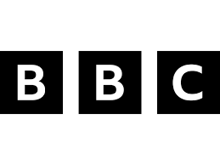


British Television and Radio
The three public bodies responsible for television and radio throughout Britain are:
1. BBC – The British Broadcasting Corporation (founded on 18 October 1922) is the major national public service broadcaster of the United Kingdom. It is the leading broadcaster in the UK and is the largest broadcaster in the world by audience figures. The BBC operates eight national television channels in the UK and ten national radio stations. BBC News and Current Affairs is the largest news organization in the world. News programmes are produced for both TV and radio stations. The BBC has a news and archive website, one of the top twenty most popular English language websites.
2. INC – The Independent Television Commission (created in the early 1990s to replace the Independent Broadcasting Authority) licences and regulates commercial television service including cable, satellite and independent teletext services.
3. The Radio Authority (officially began its regulatory and licensing role on 1st January 1991) licenses and regulates all commercial radio services on both analogue and digital platforms.

Slide 8
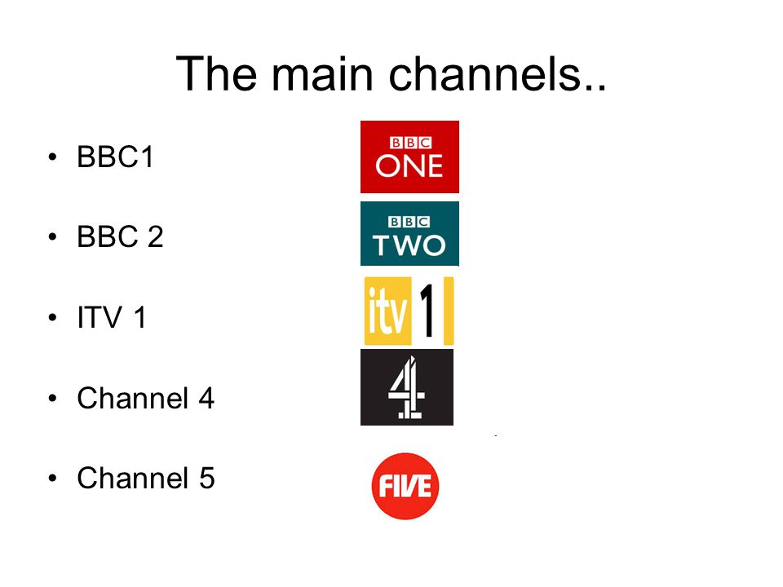
Television (colloquially known as “TV” or the “telly”)
Television broadcasting started in the United Kingdom in 1936 as public service free of advertising. Since 24 October 2012, all television broadcasts in the United Kingdom are in a digital format, following the end of analogue transmissions in Northern Ireland. About 96 per cent of the population of Britain have television in their homes. People in Britain watch on average 28 hours of TV every week. Television viewing is Britain’s most popular leisure pastime. There are five main TV channels: two national commercial free BBC networks, BBC1 and BBC2, and three commercial ITV, Channel 4 and Channel 5 services.

Slide 9

The BBC is known for its objectivity in news reporting. The BBC is financed by payments which are made by all people who have TV-sets. People have to pay the licence fee. In 1932 the BBC World Service was set up with a license to broadcast first to Empire and then to other parts of the world. There is no advertising on any BBC programme.
ITV is a commercial television and it gets its money from advertising. The programmes on this channel are financed by different companies, which do not have anything to do with the content of these programmes. ITV news programmes are not made by individual television companies. Independent television news is owned jointly by all of them. So it has been protected from commercial influence.
There are different types of TV programmes in Great Britain. BBC and ITV start early in the morning. One can watch news programmes, all kinds of chat shows, quiz shows, soap operas, different children’s programmes, dramas, comedies and different programmes of entertainment on these channels. News is broadcast at regular intervals and there are panel discussions of current events. Both the BBC and ITV broadcast educational programmes, including broadcasts for schools. The BBC also transmits programmes for Open University students. Broadcasts for schools are produced on five days of the week during school hours. In the afternoon and early evening TV stations show special programmes for children. Operas, music concerts and shows are presented at various times. A large part of TV time is occupied by serials.

Slide 10

Britain has two channels (BBC 2 and Channel 4) for presenting programmes on serious topics, which are watched with great interest by a lot of people. These channels start working on early weekday mornings. But they translate mostly all kinds of education programmes. Weekend afternoons are devoted to sport. Sport events are usually broadcast in the evening. During last 10 years, Britain’s most watched channels were ITV, with 27 per cent of all regular viewers, and BBC 1, with 21 per cent. The country is moving over to digital broadcasting, and the present analogue services will stop in 2012.
There are also cable and satellite television. The largest satellite programmer is BSkyB (British Sky Broadcasting). There are about 300 channels including some American ones like CNN. The kids’ channels include Fox Kids, Trouble TV, CBBC, and Nick Jr.

Slide 11
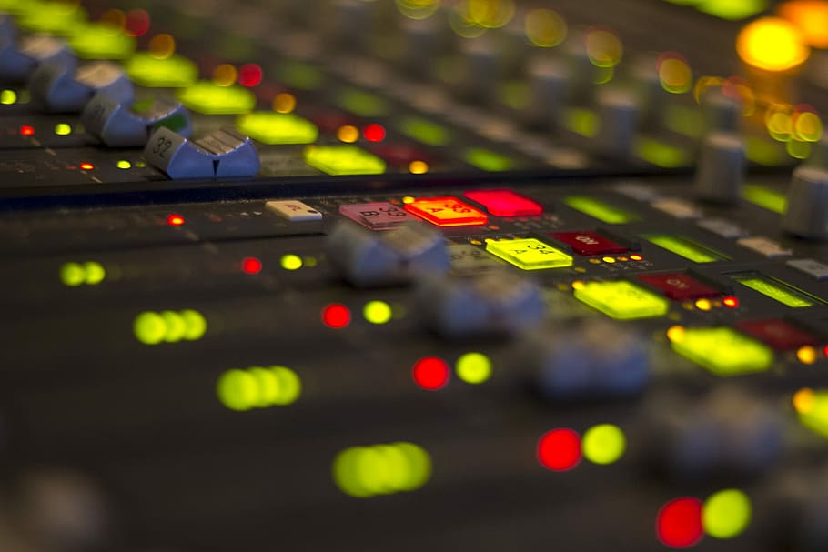
Radio
The first radio transmission consisting of Morse Code (or wireless telegraphy) was made from a temporary station set up by Guglielmo Marconi in 1895. The broadcasting of music and talk via radio started experimentally around 1905-1906, and commercially around 1920 to 1923. The BBC radio services began in 1922.
Radio enjoys a large number of British listeners. People in Britain listen to an average 21 hours and 50 minutes of radio each week. 9 in 10 people in the UK tune into the radio each week. Radio audiences have reached in 2013 an “all-time high” as more than 90 per cent of all UK adults (47.7 million), tuned in each week, figures indicate. Radio listening via mobile phone: 26% of adults, and 41% of 15-24 year olds.
The BBC has five national radio networks which together transmit all types of music, news, current affairs, drama, education, sport and a range of feature programmes.
There are also 39 BBC local radio stations, and national radio services in Scotland, Wales and Northern Ireland. The top 10 radio stations with the most listeners: BBC Radio 2 (15.1million listeners every week), BBC Radio 4 (10.5million), BBC Radio 1 (10.4 million), Heart (8.9 million), Capital FM (7.1 million), BBC Radio 5 Live (5.3 million), Classic FM (5.3 million), Kiss (5.2 million), Smooth (4.6 million), talk SPORT (3.0 million).

